Slide 1





User Meeting
Smart Meal Planning
22-05-2024
Kortrijk
Filotas Theodosiou
Data Scientist – AI Researcher

Slide 2


Agenda:
Welcome 13u10-13u15
Workshop 13u15-14u30
15 min break
Project progress 14u45-16u15
Dashboard and feedback 16u15-16u30
Network drink 16u30

Slide 3

Workshop.
Applying AI in Practise.
A (Brief) Introduction to AI.
Applying AI in Practice
Lets talk Forecasting!
Model Selection.
Takeaways!

Slide 4

A (Brief) Introduction to AI.
2024: Another Year Full of AI Hype
A Summary of Google’s I/O Keynote 2024
Try to count the number of “AI” mentions
Notes:
Cut in the middle. Yeah, you get the idea.
There is a huge hype currently around artificial intelligence. This is mainly driven by the progress on chagpt-type models
However AI is much more than that!

Slide 5
A (Brief) Introduction to AI.
Lets Start By Definitions
Intelligent Machines
Automation of intelligent behavior by computers
Artificial Intelligence
Machine Learning
Algorithms that learn from data
The process of “training” models to learn patterns in data
Deep Learning
Brain-Inspired Deep Neural Networks
Advanced ML models for more complex representations
Text/image/audio generation
Even Deeper Neural Networks: ChatGPT, Gemini etc
Gen-AI
Notes:
Give the definitions

Slide 6
A (Brief) Introduction to AI.
Machine Learning (in a Nutshell)
Training Phase
Predictions phase
Notes:
AI voor sales predictie met beperkte data
AI vraagt veel data, hoe dit doen met weinig data
Verborgen structuren uitbuiten
De kennis uit dit project kunnen we op verder bouwen in de TETRA
Raad van advies/bestuur voor KMO’s
beroep doen op externe adviseurs leidt tot verbeterde besluitvormingskwaliteit,
toegenomen strategische planning en hogere bedrijfsperformantie
Project: beter begrip bij te brengen over het scala van adviesorganen dat ter beschikking is en hun te assisteren in een meer weloverwogen keuze
BedrijfsDNA: de weg naar mensgericht werk
Mensen aan boord krijgen + houden
Aanwerving: 62 % doorslaggevend is in jobkeuze is PURPOSE
Socials Return On Investment
Links:
https://www.vives.be/nl/onderzoek/business-management/ai-voor-sales-predictie-een-omgeving-met-beperkte-historische-data
https://www.vlaamsehogescholenraad.be/nl/ai_23_sales-predictie
https://www.vives.be/nl/onderzoek/business-management/leidraad-tot-een-succesvolle-raad-van-adviesbestuur-voor-startups-en
https://www.vives.be/nl/onderzoek/business-management/company-dna-road-humancentered-organisations

Slide 7
A (Brief) Introduction to AI.
Machine Learning (in a Nutshell)
Training Phase
Predictions phase
Data Collection
Images of Cats/dogs
Historical Sales
True Labels
Cat, cat, dog, cat, etc
12, 11, 14, 50, 11
Notes:
AI voor sales predictie met beperkte data
AI vraagt veel data, hoe dit doen met weinig data
Verborgen structuren uitbuiten
De kennis uit dit project kunnen we op verder bouwen in de TETRA
Raad van advies/bestuur voor KMO’s
beroep doen op externe adviseurs leidt tot verbeterde besluitvormingskwaliteit,
toegenomen strategische planning en hogere bedrijfsperformantie
Project: beter begrip bij te brengen over het scala van adviesorganen dat ter beschikking is en hun te assisteren in een meer weloverwogen keuze
BedrijfsDNA: de weg naar mensgericht werk
Mensen aan boord krijgen + houden
Aanwerving: 62 % doorslaggevend is in jobkeuze is PURPOSE
Socials Return On Investment
Links:
https://www.vives.be/nl/onderzoek/business-management/ai-voor-sales-predictie-een-omgeving-met-beperkte-historische-data
https://www.vlaamsehogescholenraad.be/nl/ai_23_sales-predictie
https://www.vives.be/nl/onderzoek/business-management/leidraad-tot-een-succesvolle-raad-van-adviesbestuur-voor-startups-en
https://www.vives.be/nl/onderzoek/business-management/company-dna-road-humancentered-organisations

Slide 8
A (Brief) Introduction to AI.
Machine Learning (in a Nutshell)
Training Phase
Predictions phase
Data Collection
Images of Cats/dogs
Historical Sales
A predictive ML Model
(NOT TRAINED)
True Labels
Cat, cat, dog, cat, etc
12, 11, 14, 50, 11
Notes:
AI voor sales predictie met beperkte data
AI vraagt veel data, hoe dit doen met weinig data
Verborgen structuren uitbuiten
De kennis uit dit project kunnen we op verder bouwen in de TETRA
Raad van advies/bestuur voor KMO’s
beroep doen op externe adviseurs leidt tot verbeterde besluitvormingskwaliteit,
toegenomen strategische planning en hogere bedrijfsperformantie
Project: beter begrip bij te brengen over het scala van adviesorganen dat ter beschikking is en hun te assisteren in een meer weloverwogen keuze
BedrijfsDNA: de weg naar mensgericht werk
Mensen aan boord krijgen + houden
Aanwerving: 62 % doorslaggevend is in jobkeuze is PURPOSE
Socials Return On Investment
Links:
https://www.vives.be/nl/onderzoek/business-management/ai-voor-sales-predictie-een-omgeving-met-beperkte-historische-data
https://www.vlaamsehogescholenraad.be/nl/ai_23_sales-predictie
https://www.vives.be/nl/onderzoek/business-management/leidraad-tot-een-succesvolle-raad-van-adviesbestuur-voor-startups-en
https://www.vives.be/nl/onderzoek/business-management/company-dna-road-humancentered-organisations

Slide 9
A (Brief) Introduction to AI.
Machine Learning (in a Nutshell)
Training Phase
Predictions phase
Data Collection
Images of Cats/dogs
Historical Sales
A predictive ML Model
(NOT TRAINED)
True Labels
Cat, cat, dog, cat, etc
12, 11, 14, 50, 11
Notes:
What training means is how the model “learns” the function that given the input produces the output

Slide 10
A (Brief) Introduction to AI.
Machine Learning (in a Nutshell)
Training Phase
Predictions phase
Data Collection
Images of Cats/dogs
Historical Sales
A predictive ML Model
(NOT TRAINED)
A predictive ML Model
(TRAINED)
True Labels
Cat, cat, dog, cat, etc
12, 11, 14, 50, 11
Notes:
Then we take the trained ML model

Slide 11
A (Brief) Introduction to AI.
Machine Learning (in a Nutshell)
Training Phase
Predictions phase
Data Collection
Images of Cats/dogs
Historical Sales
New unseen data
Images of Cats/dogs
Historical Sales
A predictive ML Model
(NOT TRAINED)
A predictive ML Model
(TRAINED)
True Labels
Cat, cat, dog, cat, etc
12, 11, 14, 50, 11
Notes:
And we feed it a bunch of new unseen data as input

Slide 12
A (Brief) Introduction to AI.
Machine Learning (in a Nutshell)
Training Phase
Predictions phase
Data Collection
Images of Cats/dogs
Historical Sales
New unseen data
Images of Cats/dogs
Historical Sales
A predictive ML Model
(NOT TRAINED)
A predictive ML Model
(TRAINED)
True Labels
Cat, cat, dog, cat, etc
12, 11, 14, 50, 11
Predicted Labels
Cat, dog, dog, dog, etc
10, 50, 4, 55, 11
Notes:
We get new predictions

Slide 13
A (Brief) Introduction to AI.
Machine Learning (in a Nutshell)
Training Phase
Predictions phase
Data Collection
Images of Cats/dogs
Historical Sales
New unseen data
Images of Cats/dogs
Historical Sales
A predictive ML Model
(NOT TRAINED)
A predictive ML Model
(TRAINED)
True Labels
Cat, cat, dog, cat, etc
12, 11, 14, 50, 11
Predicted Labels
Cat, dog, dog, dog, etc
10, 50, 4, 55, 11
Business Decision
Notes:
And based on them we get a new busienss decision

Slide 14
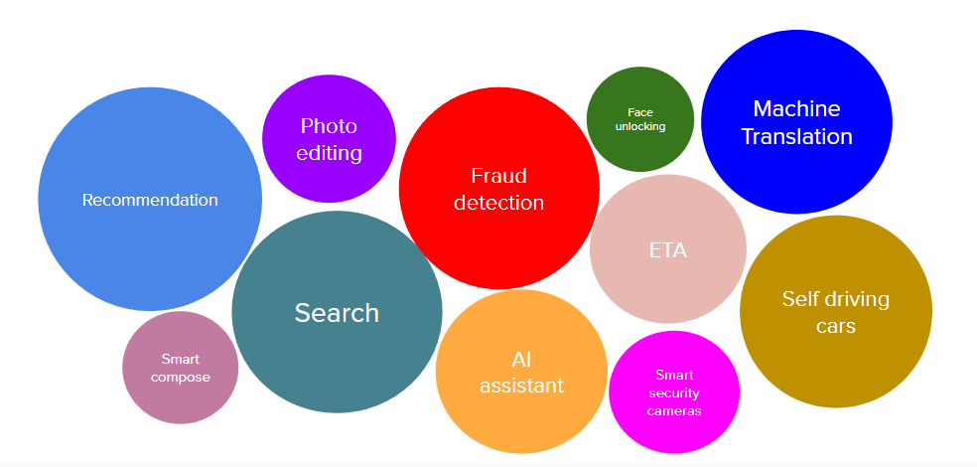
A (Brief) Introduction to AI.
And yeah… It is Everywhere!
Notes:
Currently AI models are applied in almost all domains for various tasks. You can see some examples here.

Slide 15
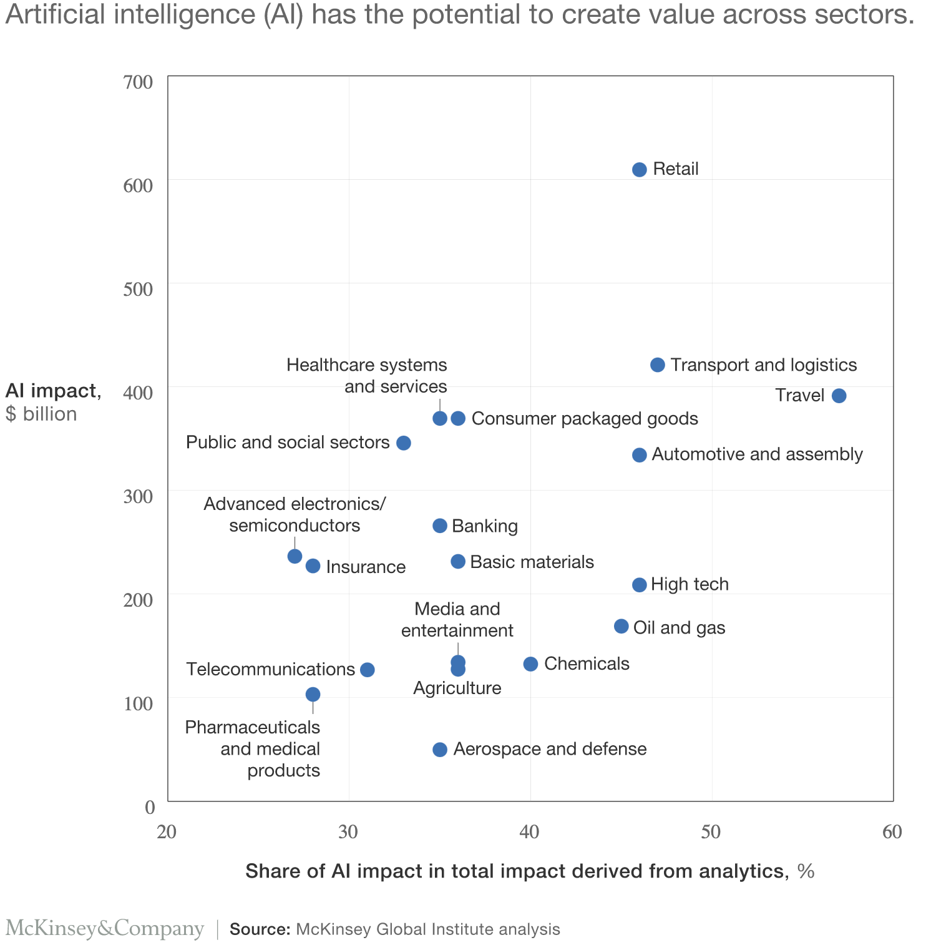
A (Brief) Introduction to AI.
And it Generates Value!
AI value creation by 2030
13 trillion USD
Most of it will be outside the consumer internet industry
Notes:
And yeah, despite the hype, its True, AI can generate a lot of value if used properly.
It expected to generate 13 trillion US dollars by 2030, an insane number.
This is a graph of how it impacts the different sectors.

Slide 16
Workshop!
Agenda!
A (Brief) Introduction to AI.
Applying AI in Practice.
Lets talk Forecasting!
Model Selection.
Takeaways!

Slide 17

Applying AI in Practise.
How to Use AI in Production: Expectations
Collect data
Train model
Use model in production
Notes:
This is what people expect when hearing we are going to use AI in practise.
You get some data, you train a model, you use it in your system and you earn millions!
Nice right?

Slide 18
Applying AI in Practise.
How to Use AI in Production: Reality
Choose a metric to optimize
Collect data
Train model
Realize data has mistakes -> rework on data
Train model
Model performs poorly on one case -> collect more data for that case
Train model
Model performs poorly on most recent data -> collect more recent data
Train model
Deploy model
Dream about $$$
Wake up at 2am to complaints that model biases against one group -> revert to older version
Get more data, train more, do more testing
Deploy model
Pray
Model performs well but revenue decreasing
Cry
Choose a different metric
Start over
Step 15 and 17 are essential
Notes:
This is the reality.
I am going to read it as

Slide 19
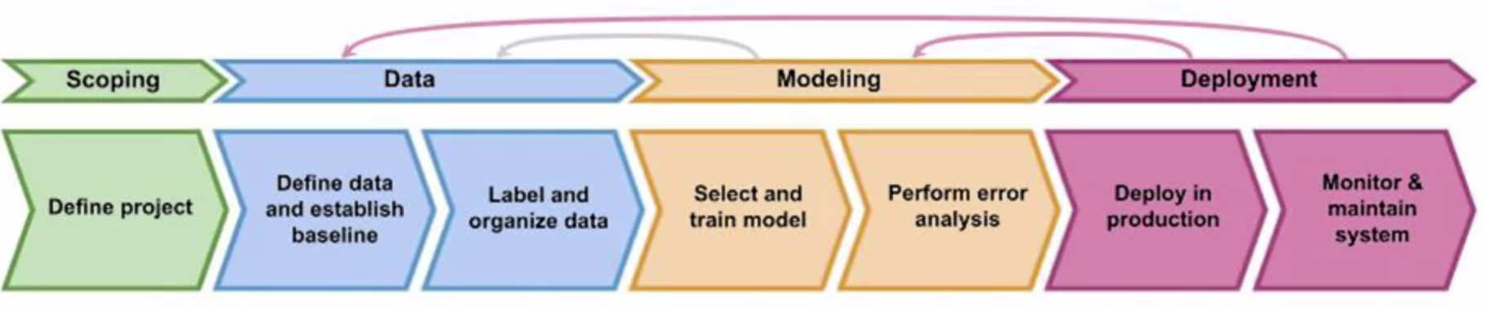
Applying AI in Practise.
The AI Project Lifecycle
Scoping: Clearly define the project, the goals, the objectives, etc
Data: Collect, extract or acquire the data needed
Modelling: “Train” an AI model and perform error analysis
Deployment: Take the model and integrate it in the production system
Notes:
Ok lets try to summarize the above. This is what it feels to have a ML application in practise.
- Scopign is always first
- Data Modelling and deployment is recurisve. We go back and forth, trying to find ways in any of these sections to make the system better!

Slide 20
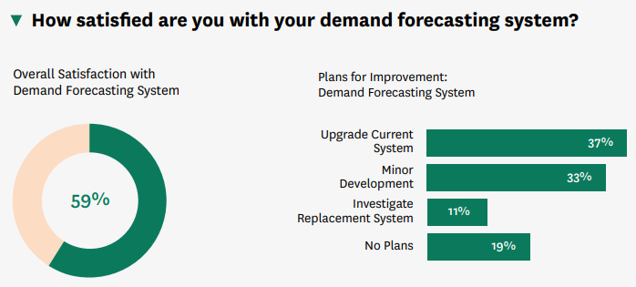
Applying AI in Practise.
The Importance of Scopping
Main Challenges for SMEs in Adopting Data-Driven Technologies
Obstacles in extracting value from data
Non integrated or outdated IT systems
Complexity of the project
These Problems are due to bad scoping!
World Economic Forum: Empowering Small and Medium Enterprises (SMEs) for Innovation and Success. Briefing paper. June 2023
Relex, Ensemble: Planning for Every Future in Grocery Retail, Survey Based Research Study. Executive Summary, January 2020
Notes:
Lets start with scoping and why its important. In my opinion non-scoped projects is the most obvious reason projects fails.
And that in some sense is validated by these findings.
Most SMES want to addopt data-driven technologies but do not know how!
And this starts with the why they need this!
They have trouble organizing the steps needed to make the change

Slide 21
Applying AI in Practise.
The Politics of AI Projects
Notes:
Lets consider a small example now to identify the problems with scoping an AI project.

Slide 22

Applying AI in Practise.
The Politics of AI Projects
Data Scientist
Bob
Develop a forecasting model
Unbiased business practices
Wants to apply it to add value
Notes:
So we have Bob. Bob is a Data Scientist, he works on developing a forecasting model for a company.
He wants to use his model to generate as much value as possible.
He does not have a strong opinion on how his model will be used, he just wants to add value.

Slide 23

Applying AI in Practise.
The Politics of AI Projects
Data Scientist
Operations Manager
Bob
Develop a forecasting model
Unbiased business practices
Wants to apply it to add value
Susan
Focuses on inventory costs
Reduces forecasts to order less inventory
Notes:
Then we have Susan. The operations Manager. Her job is to reduce the inventory costs so she earns that bonus.
What Susan does is that she takes the predictions of the model and lowers them so they order less and the pay for inventory less

Slide 24

Applying AI in Practise.
The Politics of AI Projects
Data Scientist
Operations Manager
Sales Manager
Bob
Develop a forecasting model
Unbiased business practices
Wants to apply it to add value
Susan
Focuses on inventory costs
Reduces forecasts to order less inventory
Mark
Inflates forecast for motivation
Higher target, more aggressive marketing
Notes:
Then we have Mark, the Sales manager. He is super motivated and he inflates the forecasts so he sets higher goals for his team to accomplish.

Slide 25

Applying AI in Practise.
The Politics of AI Projects
Data Scientist
Operations Manager
Sales Manager
Why did we fail?
CEO
Bob
Develop a forecasting model
Unbiased business practices
Wants to apply it to add value
Susan
Focuses on inventory costs
Reduces forecasts to order less inventory
Mark
Inflates forecast for motivation
Higher target, more aggressive marketing
Notes:
Do you see something wrong here?

Slide 26
Applying AI in Practise.
The Politics of AI Projects
Data Scientist
Operations Manager
Sales Manager
Why did we fail?
CEO
Bob
Develop a forecasting model
Unbiased business practices
Wants to apply it to add value
Susan
Focuses on inventory costs
Reduces forecasts to order less inventory
Mark
Inflates forecast for motivation
Higher target, more aggressive marketing
Not well-established scoping. Not aligned targets!
Notes:
Yeah you guessed it. Not well-established scoping. Failing will not be because of the model, but because of how the model will be used!

Slide 27
Applying AI in Practise.
The Scoping Process!
Notes:
Lets try to break down the scoping process.

Slide 28
Applying AI in Practise.
The Scoping Process!
Brainstorm business problems
Notes:
It all starts with a problem. What are we trying to solve.

Slide 29
Applying AI in Practise.
The Scoping Process!
Reduce Inventory
Increase margin
Profit more
Brainstorm business problems
Notes:
So all the decision makers sit together and brainstrom business problems they want to fix and write them down.

Slide 30
Applying AI in Practise.
The Scoping Process!
Reduce Inventory
Increase margin
Profit more
Brainstorm business problems
Brainstorm Data-driven solutions
Notes:
Then we need to find data-driven solutions

Slide 31
Applying AI in Practise.
The Scoping Process!
Reduce Inventory
Increase margin
Profit more
Brainstorm business problems
Use AI
Brainstorm Data-driven solutions
Notes:
So they go the data scientist and they present him with the business problems they have

Slide 32
Applying AI in Practise.
The Scoping Process!
Reduce Inventory
Increase margin
Profit more
Brainstorm business problems
Use AI
Brainstorm Data-driven solutions
Access feasibility and value of solutions
Determine timelines and milestones
Set budget
Notes:
And after the business solutions have been identified, and agreed these are the next steps.
- We check if the solutions are feasible
- We a timeline and some milestones to hit that timeline
- We set the budget

Slide 33
Applying AI in Practise.
Check Feasibility
How to check if a solution is feasible?
Notes:
Ok lets answer a couple of important questions. First how to check if a solution is feasible.

Slide 34
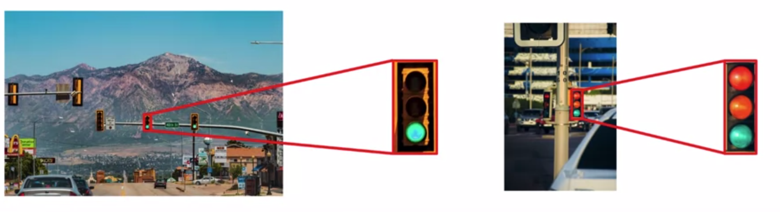
Applying AI in Practise.
Check Feasibility
How to check if a solution is feasible?
Notes:
Lets take the example of self-drivign cars. We want to identify if a traffic light is red or green.
This is an obvious answer.

Slide 35
Applying AI in Practise..
Check Feasibility
How to check if a solution is feasible?
Notes:
How about this one? How do I expect my model to classify something correctly when I cant do it on my own?

Slide 36
Applying AI in Practise.
Check Feasibility
How to check if a solution is feasible?
If something is not solvable:
Invest on other things
Better Data
Better equipment
Notes:
So in that case, a solution is not feasible given our resources. We need to invest on better data.

Slide 37
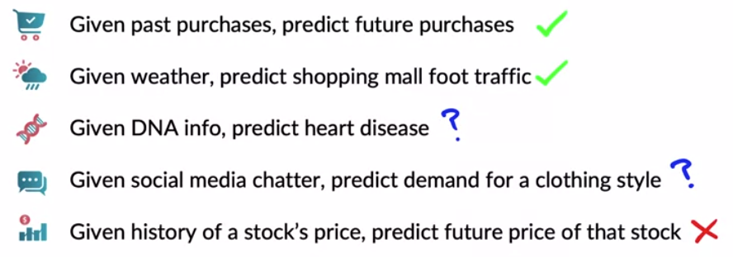
Applying AI in Practise.
Check Feasibility
How to check if a solution is feasible?
If something is not solvable:
Invest on other things
Better Data
Better equipment
Is a solution feasible given your data?
Notes:
So in general, I have to question, can I solve something given the data I have? If it does not sound realistic then probably a model will not solve it.
Fortunately or unfortunately we dont have Artificial General Inteligence.

Slide 38
Applying AI in Practise.
Value of Solutions!
How to measure the value of a solution?
Notes:
Next question. How to properly measure the value of a solution!

Slide 39
Applying AI in Practise.
Value of Solutions!
How to measure the value of a solution?
Forecasting Evaluation Metrics
Inventory metrics
Notes:
There are two worlds. The world of Bob, that uses forecasting evaluation metrics and the world of Susan that uses buisness metrics

Slide 40
Applying AI in Practise.
Value of Solutions!
How to measure the value of a solution?
Forecasting Evaluation Metrics
Inventory metrics
Main
Goal
Main
Goal
Accurate forecasts
Low inventory costs
Notes:
One wants to have accurate forecasts, the other wants to have low inventory costs

Slide 41
Applying AI in Practise.
Value of Solutions!
How to measure the value of a solution?
Forecasting Evaluation Metrics
Inventory metrics
Common Ground
Minimize Costs
Main
Goal
Main
Goal
Accurate forecasts
Low inventory costs
Notes:
We need to find a common ground here. We need to align our targets. We need to have a shared vision

Slide 42
Applying AI in Practise.
Value of Solutions!
How to measure the value of a solution?
Forecasting Evaluation Metrics
Inventory metrics
Common Ground
Minimize Costs
Main
Goal
Main
Goal
Aim
Test connection accuracy - inventory
Consider forecasts for inventory planning
Aim
Accurate forecasts
Low inventory costs
Notes:
So both need to take a step towards the common ground.
Bob would research the connection between accuracy and inventory and optimize his model for that end
Susan will start considering how the forecasts can be used to assist her inventory planning

Slide 43
Applying AI in Practise.
Value of Solutions!
How to measure the value of a solution?
Forecasting Evaluation Metrics
Inventory metrics
Common Ground
Minimize Costs
Main
Goal
Main
Goal
Aim
Test connection accuracy - inventory
Consider forecasts for inventory planning
Aim
Accurate forecasts
Low inventory costs
Technical and business teams should agree on common metrics (comfortable for both)
Notes:
And thats the takeaway!

Slide 44
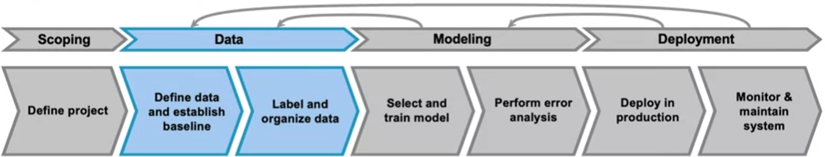
Applying AI in Practise.
Data!
Notes:
Good, now that we finished scoping, lets move to data!!

Slide 45
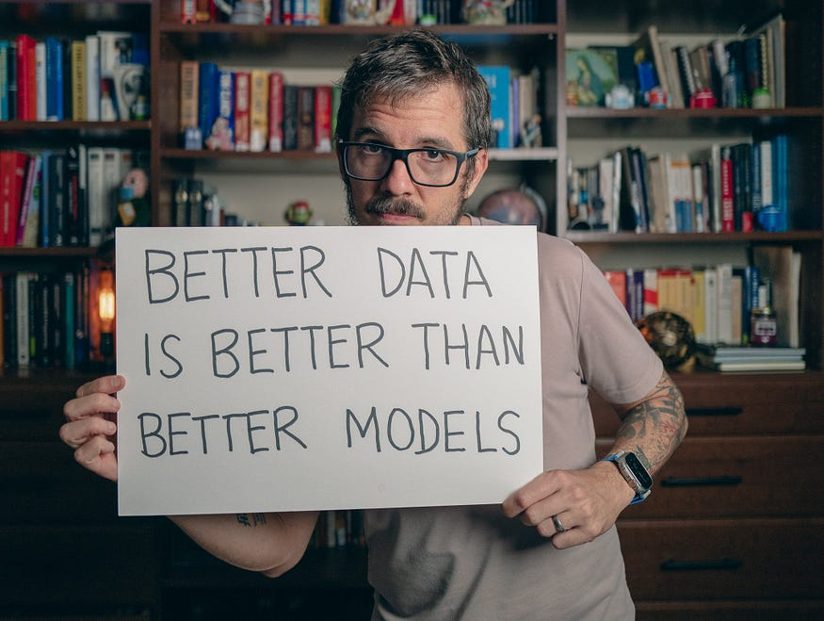
Applying AI in Practise.
The Golden Rule.
Source: underfitted, twitter
Notes:
This is one my favourite pictures! I cannot stress it more.
Better Data is better than better models. ALWAYS!!

Slide 46
Applying AI in Practise.
Better Data over Better Models
Why better data is more important than better models?
Notes:
I hear you asking why. Good question, lets see!

Slide 47



Applying AI in Practise.
Better Data over Better Models
“Dog”
Why better data is more important than better models?
“Dog”
Models are only as good as their training data.
Regardless the model, if data is bad or biased, results will be too!
AI Model
“Dog”
Notes:
Consider this example. I give my model picture of cats and I label them as Dog. What do I expect my model to predict?
Is there some sort of wizardy inside the model? No!
If my data is biased or wrong, then the predictions will be biased and wrong.
Thats why all big labs, Google OpenAI, fight to get good, clean data!

Slide 48
Applying AI in Practise.
Better Data over Better Models
“Dog”
Why better data is more important than better models?
“Dog”
Models are only as good as their training data.
Regardless the model, if data is bad or biased, results will be too!
AI Model
“Dog”
2. Personalized data MATTERS!!
Data should match the domain, so the model can “understand”
Notes:
Data should match the domain.
I cannot train a forecasting model to predict sales of tomatos and then use it to predict how many times I open my fridge at night!
A model needs to understand what is going on.

Slide 49

Applying AI in Practise.
Better Data over Better Models
“Dog”
Why better data is more important than better models?
“Dog”
Models are only as good as their training data.
Regardless the model, if data is bad or biased, results will be too!
AI Model
“Dog”
2. Personalized data MATTERS!!
Data should match the domain, so the model can “understand”
3. Informative (and lots of) data is the key!
Explain variability of the tasks with more examples
Tesla self-driving car thought the eclipse was a red light
Notes:
And finaly in order to explain variability in the data I need to have specialized examples to cover all cases!
This is an example of a Tesla predicing that the eclipse was a red light simply because it did not have images of eclipses on the training set.
So in order to predict the extreme cases we need to have such extreme examples in our datasets.

Slide 50
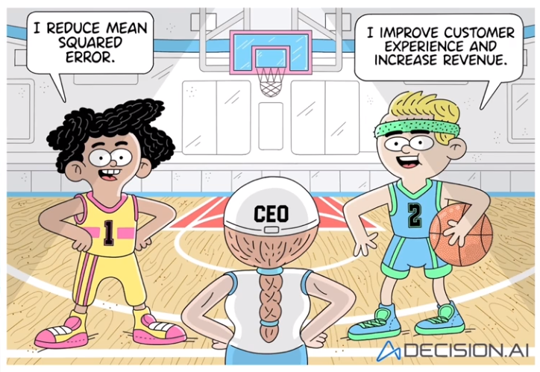
Applying AI in Practise.
Key Takeaways
Before building an AI model:
Clearly decide the details of the task.
Align business/technical needs.
Decide on the metrics and set targets.
Collect high quality data.
Notes:
So to summarize!
Before building an AI model to solve a task, first answer these questions!
Or you will end up in this siuation with Bob and Susan!

Slide 51
Workshop.
Agenda!
A (Brief) Introduction to AI.
Applying AI in Practice.
Lets talk Forecasting!
Model Selection.
Takeaways!
Notes:
Good, any questions so far? How are we on time?
Good, lets switch gears no. Lets go talk about Forecasting.
We will discuss some things that are important for the project progress.

Slide 52

Lets talk Forecasting.
What is the Point of Forecasting?
“A wall of wood alone shall be uncaptured, a boon to you and your children”, 480 BC
- Herodotus, The Persian Wars, Volume 1
King Algeus in front of Pythia at the Oracle of Delphi, 440-430 BC
Notes:
We will start with ancient Greece. Before every major event kings went to Pythea, the oracle of Delphi to learn the future.
So the myth says that during the persian wars, the Atheninas went to the oracle to ask how to stop the Persians and this is what the oracle said about the future
The Atheninas took that and based on this predictions, they took their ships and left to an island, leaving the persians to simply rush to Athenes.
Eventualy, following this decision, the greeks won the war.

Slide 53
Lets talk Forecasting.
What is the Point of Forecasting?
“Planning is bringing the future into the present so you can do something about it now”
We want to predict the future in order to act now!
Every decision under uncertainty requires a forecast
To formalize: Forecasting is a tool to support decision making
Notes:
So in a nutshell, we use forecasting to predict the future, and take a decision now to influence it.
It’s a tool that supports decision making.

Slide 54
Lets talk Forecasting.
What is the Point of Forecasting?
“Planning is bringing the future into the present so you can do something about it now”
We want to predict the future in order to act now!
Every decision under uncertainty requires a forecast
To formalize: Forecasting is a tool to support decision making
Examples:
Forecast the weather to decide clothing.
Forecast the number of tourists to prepare summer investments.
Forecast the demand of a product to optimize your inventory.
Notes:
And some examples here!

Slide 55

Lets talk Forecasting.
Forecasting is not the End Goal.
Predict
Notes:
Whats important to remember is that forecasting is not the end goal.
Lets take the example of a pirate ship.
We accurately predict that what we observe is an English ship

Slide 56

Lets talk Forecasting.
Forecasting is not the End Goal
Make a decision
Predict
Notes:
And based on that we make a decision.

Slide 57

Lets talk Forecasting.
Forecasting is not the End Goal
Make a decision
Predict
Solve a business task
Notes:
Why? To solve a bussiness task.

Slide 58
Lets talk Forecasting.
Forecasting is not the End Goal
Make a decision
Predict
Solve a business task
Notes:
And then we predict again!

Slide 59
Lets talk Forecasting.
Forecasting is not the End Goal
Make a decision
Predict
Accurate forecasts
Good business decisions
Solve a business task
(In)Accurate forecasts should be not confused with business goals
Notes:
But the fact that we predicted something right, does not mean that we took the correct decision.

Slide 60
Lets talk Forecasting.
Why Forecasting is not Enough?
The situation:
A ready-meal retailer has steady growth.
Their forecasting model has high accuracy
The forecast:
Model predicts 20% increase in demand the next year
The decision:
Expand production capacity by ordering more.
The outcome:
The forecast was very accurate (21% increase).
The expansion lead to future losses.
Notes:
Give an example from meal demand forecasting.

Slide 61
Lets talk Forecasting.
Why Forecasting is not Enough?
The situation:
A ready-meal retailer has steady growth.
Their forecasting model has high accuracy
What happened?
The expansion was too rapid, resulting in operational issues and supply chain disruptions
The forecast:
Model predicts 20% increase in demand the next year
The decision:
Expand production capacity by ordering more.
The outcome:
The forecast was very accurate (21% increase).
The expansion lead to future losses.
Notes:
Give an example from meal demand forecasting.

Slide 62
Lets talk Forecasting.
Why Forecasting is not Enough?
The situation:
A ready-meal retailer has steady growth.
Their forecasting model has high accuracy
What happened?
The expansion was too rapid, resulting in operational issues and supply chain disruptions
The forecast:
Model predicts 20% increase in demand the next year
The decision:
Expand production capacity by ordering more.
The takeaway:
Accurate forecasts
Good business decisions
The outcome:
The forecast was very accurate (21% increase).
The expansion lead to future losses.
Notes:
Give an example from meal demand forecasting.

Slide 63
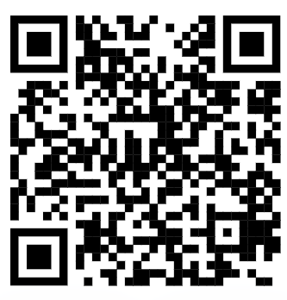
A Quick Note!
This is an interactive presentation!
Scan this:
Use code: 1200 9946
Notes:
If you have quesiton interupt -> mention this

Slide 64
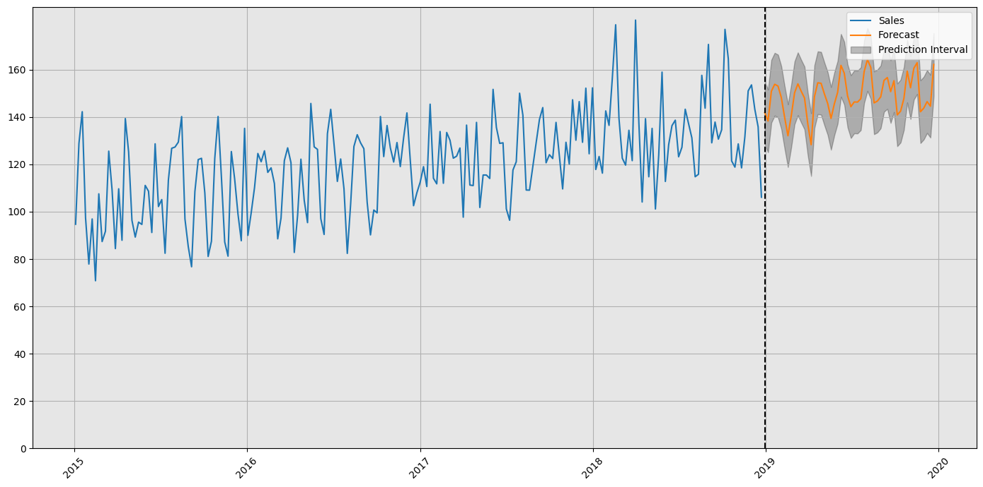
Lets talk Forecasting.
What Makes a Good Forecast?
Consider this:
Time series:
A series of data points, representing some action, across a time span.
Notes:
This is a time series, it represents the some action in a specific timespan
In our case this is daily sales of an item from 2015 to 2019.

Slide 65
Lets talk Forecasting.
What Makes a Good Forecast?
Consider this:
Time series forecasting.
The process of analyzing a time series and trying to predict the next observation (action) in the sequence.
Notes:
And this is a forecast. We try to predict how the signal will proceed in time.
We can use anything, a model our intuition whatever fits us

Slide 66
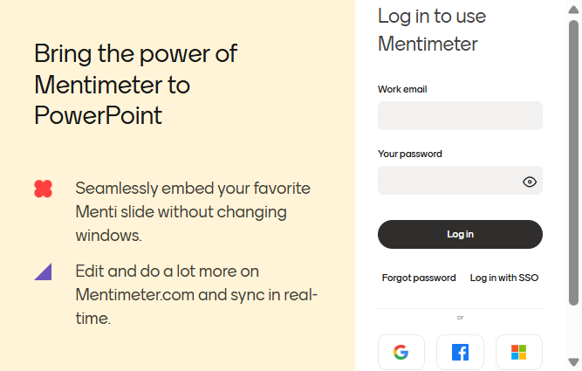
Lets talk Forecasting.
What Makes a Good Forecast?
Consider this:
Notes:
And I am asking you, do you believe that this is a good forecast?
Does my prediction matches what was happening in the past?

Slide 67
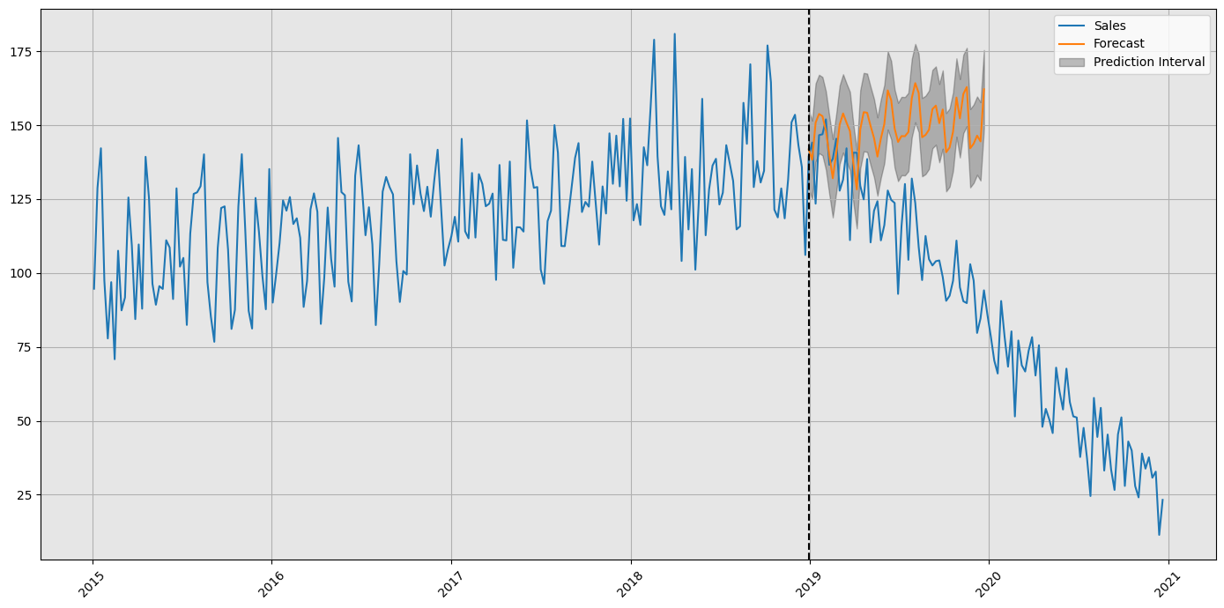
Lets talk Forecasting.
What Makes a Good Forecast?
Consider this:
What about now?
Notes:
Suprise!!

Slide 68
Lets talk Forecasting.
What Makes a Good Forecast?
Consider this.
What about now?
Pandemic
Notes:
The pandemic hit us!

Slide 69
Lets talk Forecasting.
What Makes a Good Forecast?
Consider this.
What about now?
There are no good forecasts
We never know if a forecast is good enough!
Only when we have the realization of demand.
Pandemic
Notes:
So the takeaway is that we cannot predict the future with 100% precision.
That means that there are no good forecasts! We will never be 100% accurate.

Slide 70
Lets talk Forecasting.
What Makes a Good Forecast?
Consider this.
What about now?
There are no good forecasts
We never know if a forecast is good enough!
Only when we have the realization of demand.
Pandemic
What we can do instead?
Improve the way we approach forecasting!
Notes:
So what we can do instead? Lets improve the way we do forecasting and maximize the probability of success.

Slide 71
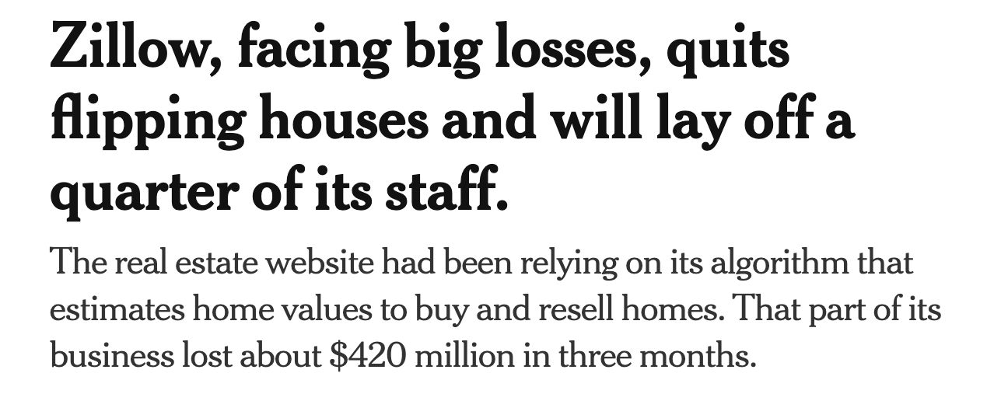

Lets talk Forecasting.
Bad Forecasting Practises: An Example.
Notes:
Lets consider another example. Lets consider Zillow!
So zillow is a real estate company that forecasted the future value of homes, finds opportunities for houses with increasing costs,
Buys them and then sells them
What happened is that Zillow 420millions in just three months and eventualy had to shut the business down!

Slide 72

Lets talk Forecasting.
Bad Forecasting Practises: An Example
What happened with Zillow??
Zillow’s invested in houses much more than their actual price.
Notes:
So what happened? They ivnested in houses with much more than their actual price

Slide 73
Lets talk Forecasting.
Bad Forecasting Practises: An Example
What happened with Zillow??
Zillow’s invested in houses much more than their actual price.
Why??
Their forecasting model overestimated the future price!
Notes:
How did that happen?
Their model overestiamted the future price

Slide 74
Lets talk Forecasting.
Bad Forecasting Practises: An Example
What happened with Zillow??
Zillow’s invested in houses much more than their actual price.
Why??
Their forecasting model overestimated the future price!
Wow! Lets not trust forecasting models never again!
Notes:
And you might think, yeah ok, lets not trust our model again.

Slide 75
Lets talk Forecasting.
Bad Forecasting Practises: An Example
What happened with Zillow??
Zillow’s invested in houses much more than their actual price.
Why??
Their forecasting model overestimated the future price!
Wow! Lets not trust forecasting models never again!
No!
Zillow’s model did not account for issues such as
Complex dynamics of housing market
Local patterns
Did not retrain to account for data drift!
Notes:
Nop thats wrong. Zillow’s forecasting practise was bad. Expecially the way they handled their data!

Slide 76
Lets talk Forecasting.
Bad Forecasting Practises: An Example
What happened with Zillow??
Zillow’s invested in houses much more than their actual price.
Why??
Their forecasting model overestimated the future price!
Wow! Lets not trust forecasting models never again!
No!
Zillow’s model did not account for issues such as
Complex dynamics of housing market
Local patterns
Did not retrain to account for data drift!
Key takeaway: There are no bad forecasts, only bad forecasting practices
Notes:
Takeaway: No bad forecasts, only bad practises!!

Slide 77
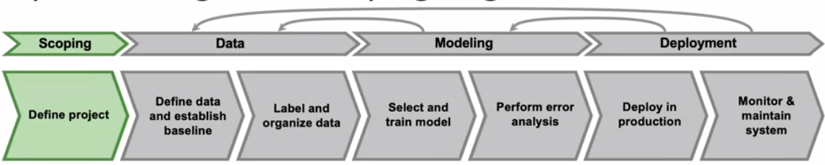
Lets talk Forecasting.
Scoping in Forecasting Tasks
What we want to forecast?
Why we want to forecast this?
Is it feasible?
Does my solution add value?
Notes:
So lets scope our forecasting practises.
As mentioned, we want to answer the following questions.

Slide 78
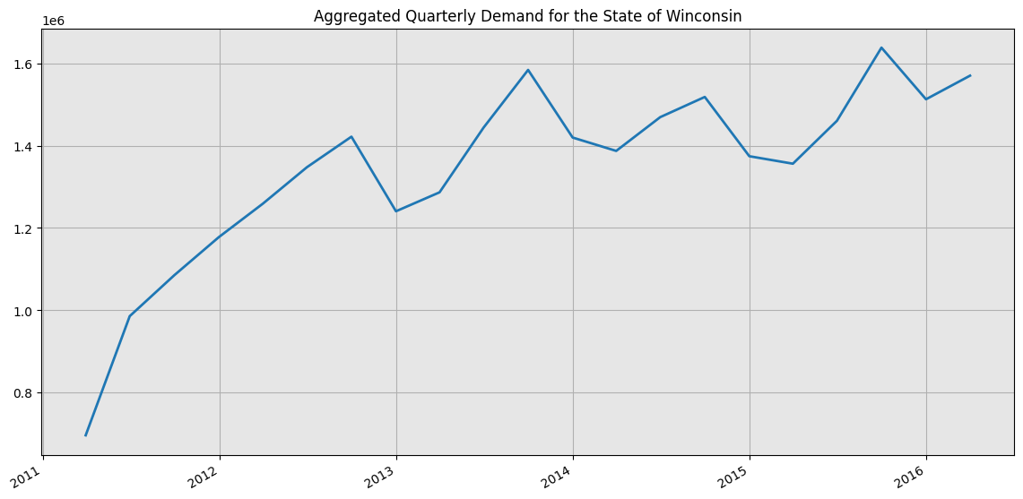
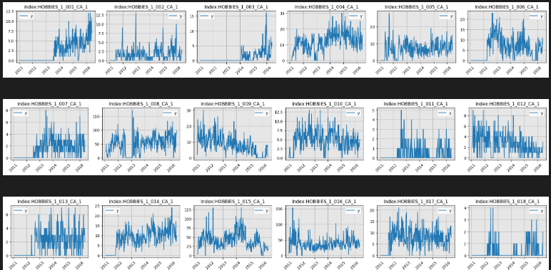
Lets talk Forecasting.
Scoping: Determine What to Forecast
Strategic Forecasts
What are we forecasting? (eg product demand, revenue?)
Why are we forecasting this?
  Operational (short term decision)
  Tactical (mid-term decisions)
  Strategic (long-term decisions)
How far into the future are forecasting?
What is the frequency? (eg daily, weekly etc)
What is the level? (eg product group, store etc)
Operational Forecasts
Notes:
Starting with what we want to forecast!
Clearly decide what you are forecasting
Then decide on why are you doing tjat. What decision do you want to support
Operational, multiple forecasts on product level for low frequency (say daily) for inventory replenishment
Strategic -> total sales on quarterly level for potential expansion
3. Then comes the details.

Slide 79
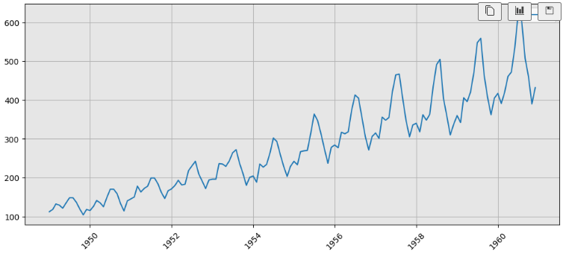
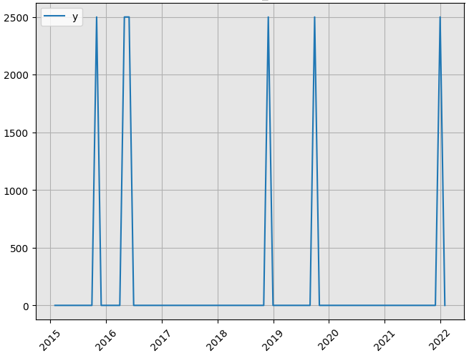
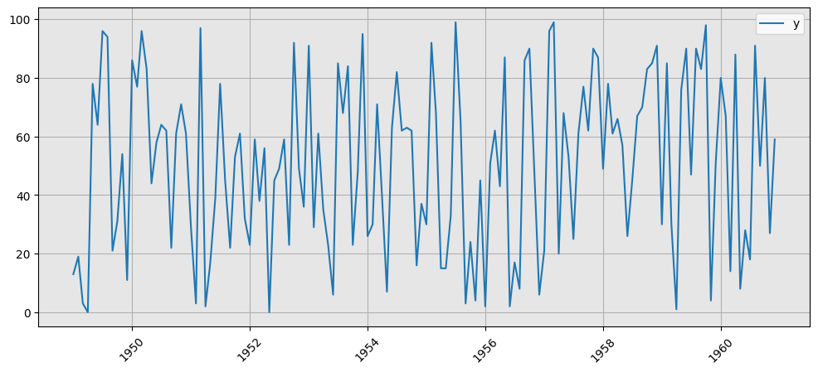
Lets talk Forecasting.
Feasibility! What Can We Forecast!
Notes:
Next is feasibility. We need to ask ourselves. Are our time series forecastable? Can we actualy forecast these?
Explain the time series one by one in detail

Slide 80
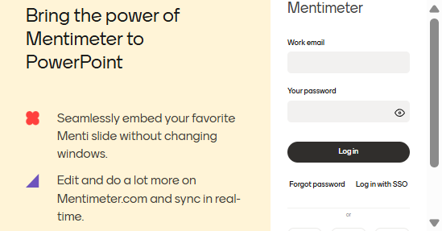
Lets talk Forecasting.
Feasibility! What Can We Forecast!
Notes:
And I am asking you. How many of these time series you believe you can predict.
Everything is sales here!
So the answer is 1, maybe 2. The third one is random numbers! The second one is very hard to forecast and the first one is very easy!

Slide 81
Lets talk Forecasting.
Feasibility! What Can We Forecast!
There is a threshold on “how much” we can predict
Otherwise every forecaster would be a billionaire!
Notes:
Explain what happens with every time series and why it is easy or hard.

Slide 82
Lets talk Forecasting.
Measure the Added Value!
How to evaluate a forecast?
Notes:
So how do we know that we did a good job with our forecasting!

Slide 83
Lets talk Forecasting.
Measure the Added Value!
How to evaluate a forecast?
Ideal world:
Evaluate on the context of the Business Task!
(eg inventory performance, costs/gains)
Very Precise
Very difficult to be estimated
Notes:
In the ideal world we would evaluate on the actual business task.
Did it increase our revenu? Yes/No
Despite being very precise, its very difficult to actualy find and decompose the value of the forecast

Slide 84
Lets talk Forecasting.
Measure the Added Value!
How to evaluate a forecast?
Ideal world:
Evaluate on the context of the Business Task!
(eg inventory performance, costs/gains)
Very Precise
Very difficult to be estimated
Reality:
Evaluate how close the forecast is to the actual value
(Forecasting Metrics)
Cheap and easy to use
Remember, good forecasts good decisions
Notes:
So what we do instead, we evaluate some property of the forecast.
And we use some forecasting errors for that. The difference between the actual value and the predicted.
While not showing one-one correlation with teh acctual business task its very easy to use.

Slide 85
Lets talk Forecasting.
Measure the Added Value!
How to evaluate a forecast?
Ideal world:
Evaluate on the context of the Business Task!
(eg inventory performance, costs/gains)
Very Precise
Very difficult to be estimated
Reality:
Evaluate how close the forecast is to the actual value
(Forecasting Metrics)
Cheap and easy to use
Remember, good forecasts good decisions
Forecasting Error Metric: A number that evaluates the goodness of the forecast!
Notes:
So what we do instead, we evaluate some property of the forecast.
And we use some forecasting errors for that. The difference between the actual value and the predicted.
While not showing one-one correlation with teh acctual business task its very easy to use.

Slide 86
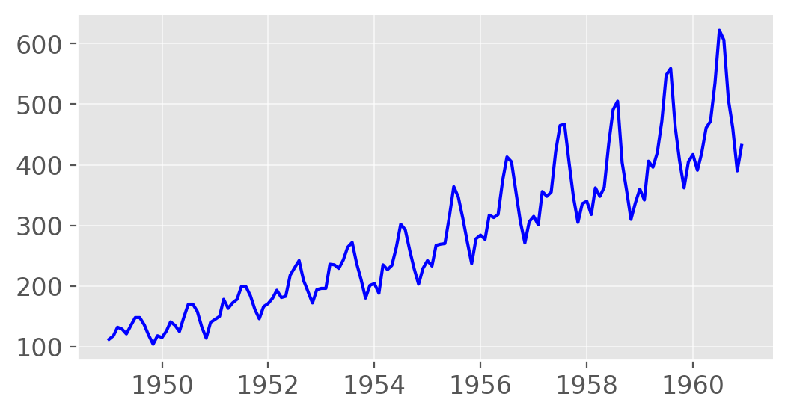
Lets talk Forecasting.
How to Evaluate a Forecast?
Notes:
Link with the previous slide. How to evaluate in reality.
Say we have a time series

Slide 87
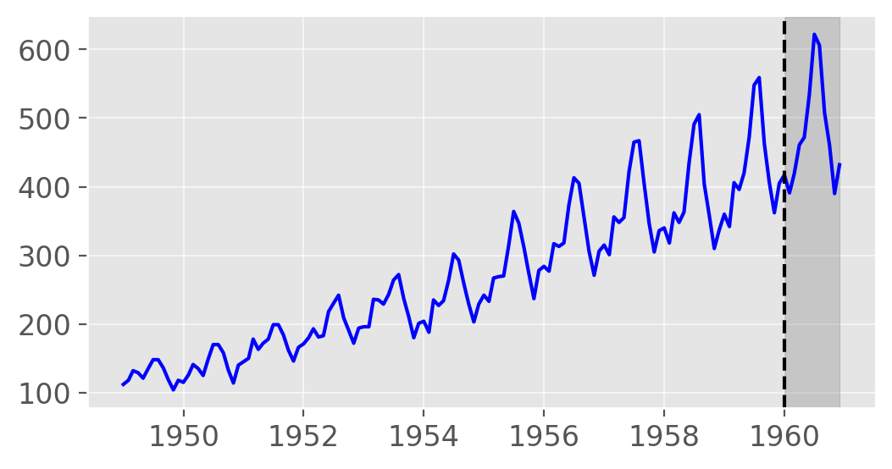
Lets talk Forecasting.
How to Evaluate a Forecast?
Train set
Test set
Step 1: Split and keep a period as a “test set”.
Notes:
AI voor sales predictie met beperkte data
AI vraagt veel data, hoe dit doen met weinig data
Verborgen structuren uitbuiten
De kennis uit dit project kunnen we op verder bouwen in de TETRA
Raad van advies/bestuur voor KMO’s
beroep doen op externe adviseurs leidt tot verbeterde besluitvormingskwaliteit,
toegenomen strategische planning en hogere bedrijfsperformantie
Project: beter begrip bij te brengen over het scala van adviesorganen dat ter beschikking is en hun te assisteren in een meer weloverwogen keuze
BedrijfsDNA: de weg naar mensgericht werk
Mensen aan boord krijgen + houden
Aanwerving: 62 % doorslaggevend is in jobkeuze is PURPOSE
Socials Return On Investment
Links:
https://www.vives.be/nl/onderzoek/business-management/ai-voor-sales-predictie-een-omgeving-met-beperkte-historische-data
https://www.vlaamsehogescholenraad.be/nl/ai_23_sales-predictie
https://www.vives.be/nl/onderzoek/business-management/leidraad-tot-een-succesvolle-raad-van-adviesbestuur-voor-startups-en
https://www.vives.be/nl/onderzoek/business-management/company-dna-road-humancentered-organisations

Slide 88
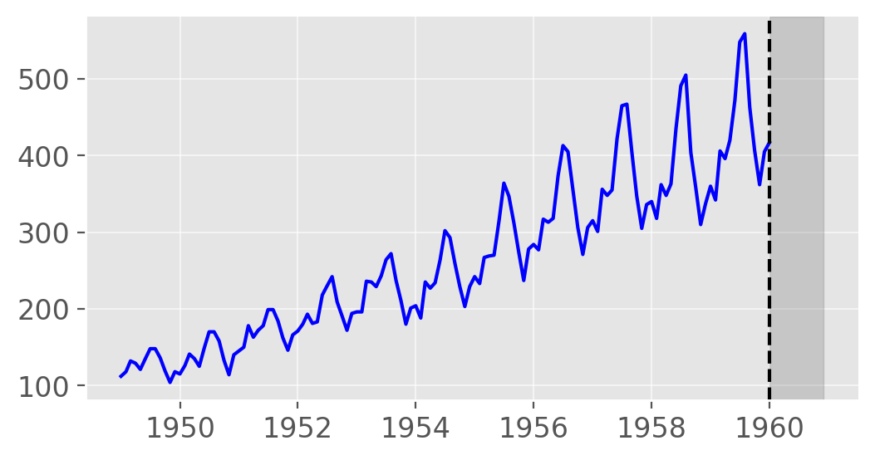
Lets talk Forecasting.
How to Evaluate a Forecast?
Step 1: Split and keep a period as a “test set”.
Step 2: “Train” a model on the “train” set.
Train
Model
Notes:
AI voor sales predictie met beperkte data
AI vraagt veel data, hoe dit doen met weinig data
Verborgen structuren uitbuiten
De kennis uit dit project kunnen we op verder bouwen in de TETRA
Raad van advies/bestuur voor KMO’s
beroep doen op externe adviseurs leidt tot verbeterde besluitvormingskwaliteit,
toegenomen strategische planning en hogere bedrijfsperformantie
Project: beter begrip bij te brengen over het scala van adviesorganen dat ter beschikking is en hun te assisteren in een meer weloverwogen keuze
BedrijfsDNA: de weg naar mensgericht werk
Mensen aan boord krijgen + houden
Aanwerving: 62 % doorslaggevend is in jobkeuze is PURPOSE
Socials Return On Investment
Links:
https://www.vives.be/nl/onderzoek/business-management/ai-voor-sales-predictie-een-omgeving-met-beperkte-historische-data
https://www.vlaamsehogescholenraad.be/nl/ai_23_sales-predictie
https://www.vives.be/nl/onderzoek/business-management/leidraad-tot-een-succesvolle-raad-van-adviesbestuur-voor-startups-en
https://www.vives.be/nl/onderzoek/business-management/company-dna-road-humancentered-organisations

Slide 89
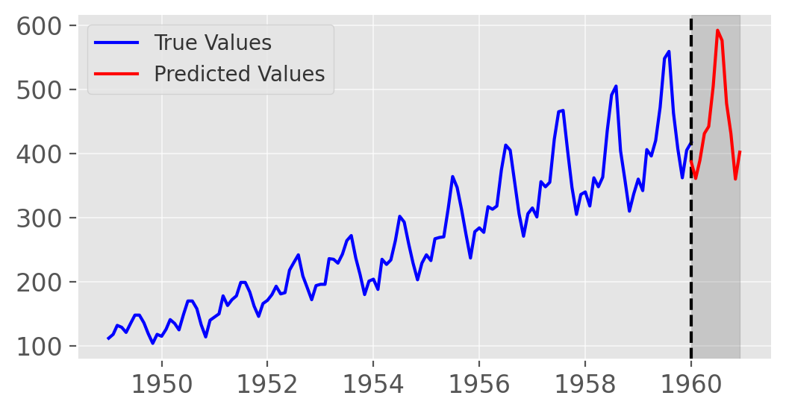
Lets talk Forecasting.
How to Evaluate a Forecast?
Step 1: Split and keep a period as a “test set”.
Step 2: “Train” a model on the “train” set.
Step 3: Make predictions for the “test” set.
Predict
Model
Notes:
AI voor sales predictie met beperkte data
AI vraagt veel data, hoe dit doen met weinig data
Verborgen structuren uitbuiten
De kennis uit dit project kunnen we op verder bouwen in de TETRA
Raad van advies/bestuur voor KMO’s
beroep doen op externe adviseurs leidt tot verbeterde besluitvormingskwaliteit,
toegenomen strategische planning en hogere bedrijfsperformantie
Project: beter begrip bij te brengen over het scala van adviesorganen dat ter beschikking is en hun te assisteren in een meer weloverwogen keuze
BedrijfsDNA: de weg naar mensgericht werk
Mensen aan boord krijgen + houden
Aanwerving: 62 % doorslaggevend is in jobkeuze is PURPOSE
Socials Return On Investment
Links:
https://www.vives.be/nl/onderzoek/business-management/ai-voor-sales-predictie-een-omgeving-met-beperkte-historische-data
https://www.vlaamsehogescholenraad.be/nl/ai_23_sales-predictie
https://www.vives.be/nl/onderzoek/business-management/leidraad-tot-een-succesvolle-raad-van-adviesbestuur-voor-startups-en
https://www.vives.be/nl/onderzoek/business-management/company-dna-road-humancentered-organisations

Slide 90
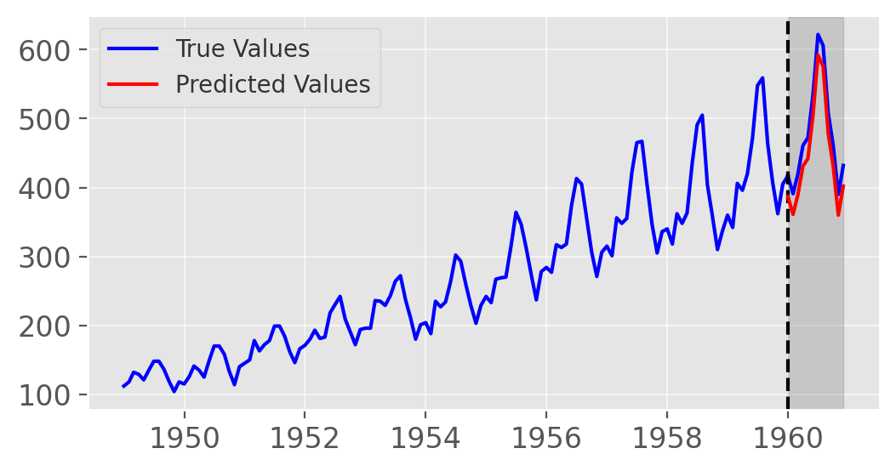
Lets talk Forecasting.
How to Evaluate a Forecast?
Step 1: Split and keep a period as a “test set”.
Step 2: “Train” a model on the “train” set.
Step 3: Make predictions for the “test” set.
Step 4: Compare predictions with the true values using a “Forecasting Error Metric”
Notes:
AI voor sales predictie met beperkte data
AI vraagt veel data, hoe dit doen met weinig data
Verborgen structuren uitbuiten
De kennis uit dit project kunnen we op verder bouwen in de TETRA
Raad van advies/bestuur voor KMO’s
beroep doen op externe adviseurs leidt tot verbeterde besluitvormingskwaliteit,
toegenomen strategische planning en hogere bedrijfsperformantie
Project: beter begrip bij te brengen over het scala van adviesorganen dat ter beschikking is en hun te assisteren in een meer weloverwogen keuze
BedrijfsDNA: de weg naar mensgericht werk
Mensen aan boord krijgen + houden
Aanwerving: 62 % doorslaggevend is in jobkeuze is PURPOSE
Socials Return On Investment
Links:
https://www.vives.be/nl/onderzoek/business-management/ai-voor-sales-predictie-een-omgeving-met-beperkte-historische-data
https://www.vlaamsehogescholenraad.be/nl/ai_23_sales-predictie
https://www.vives.be/nl/onderzoek/business-management/leidraad-tot-een-succesvolle-raad-van-adviesbestuur-voor-startups-en
https://www.vives.be/nl/onderzoek/business-management/company-dna-road-humancentered-organisations

Slide 91
Lets talk Forecasting.
How to Evaluate a Forecast?
Step 1: Split and keep a period as a “test set”.
Step 2: “Train” a model on the “train” set.
Step 3: Make predictions for the “test” set.
Step 4: Compare predictions with the true values using a “Forecasting Error Metric”
Example Forecasting Error metrics:
$$Error=Forecast−Demand$$
Notes:
AI voor sales predictie met beperkte data
AI vraagt veel data, hoe dit doen met weinig data
Verborgen structuren uitbuiten
De kennis uit dit project kunnen we op verder bouwen in de TETRA
Raad van advies/bestuur voor KMO’s
beroep doen op externe adviseurs leidt tot verbeterde besluitvormingskwaliteit,
toegenomen strategische planning en hogere bedrijfsperformantie
Project: beter begrip bij te brengen over het scala van adviesorganen dat ter beschikking is en hun te assisteren in een meer weloverwogen keuze
BedrijfsDNA: de weg naar mensgericht werk
Mensen aan boord krijgen + houden
Aanwerving: 62 % doorslaggevend is in jobkeuze is PURPOSE
Socials Return On Investment
Links:
https://www.vives.be/nl/onderzoek/business-management/ai-voor-sales-predictie-een-omgeving-met-beperkte-historische-data
https://www.vlaamsehogescholenraad.be/nl/ai_23_sales-predictie
https://www.vives.be/nl/onderzoek/business-management/leidraad-tot-een-succesvolle-raad-van-adviesbestuur-voor-startups-en
https://www.vives.be/nl/onderzoek/business-management/company-dna-road-humancentered-organisations

Slide 92
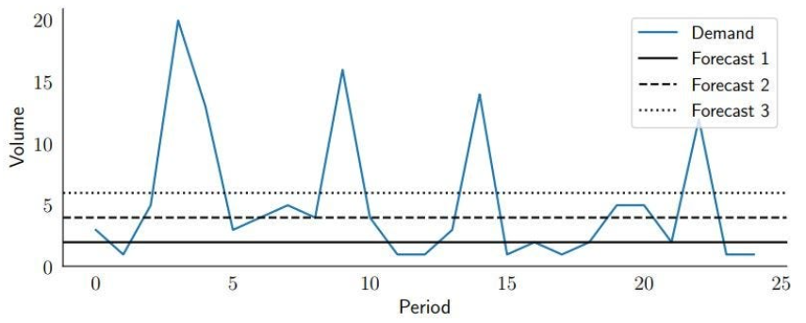
Lets talk Forecasting.
Different Error Metrics Lead to Different Results
Notes:
Expain the time series and say each forecast is produced by a different model

Slide 93
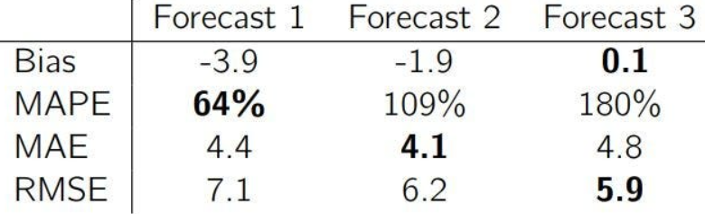
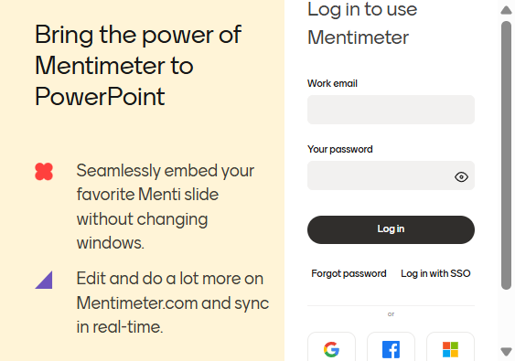
Lets talk Forecasting.
Different Error Metrics Lead to Different Results
Does that help?
Notes:
Maybe make this interactive

Slide 94
Lets talk Forecasting.
Different Error Metrics Lead to Different Results
Does that help?
Metric 1
Metric 2
Metric 3
Notes:
Maybe make this interactive

Slide 95
Lets talk Forecasting.
Different Error Metrics Lead to Different Results
Different forecasting metrics have different properties
Bad metric selection leads to bad decisions
Best practice: Use multiple metrics!
Metric 1
Metric 2
Metric 3
Notes:
Maybe make this interactive

Slide 96
Lets talk Forecasting.
Pitfalls in Forecast Evaluation!
Common Forecasting Practice
Pick a model
Forecast
Make a decision
Notes:
Lets now review the forecasting pipeline

Slide 97
Lets talk Forecasting.
Pitfalls in Forecast Evaluation!
Common Forecasting Practice
How to pick a model?
Pick a model
Forecast
Make a decision
Notes:
AI voor sales predictie met beperkte data
AI vraagt veel data, hoe dit doen met weinig data
Verborgen structuren uitbuiten
De kennis uit dit project kunnen we op verder bouwen in de TETRA
Raad van advies/bestuur voor KMO’s
beroep doen op externe adviseurs leidt tot verbeterde besluitvormingskwaliteit,
toegenomen strategische planning en hogere bedrijfsperformantie
Project: beter begrip bij te brengen over het scala van adviesorganen dat ter beschikking is en hun te assisteren in een meer weloverwogen keuze
BedrijfsDNA: de weg naar mensgericht werk
Mensen aan boord krijgen + houden
Aanwerving: 62 % doorslaggevend is in jobkeuze is PURPOSE
Socials Return On Investment
Links:
https://www.vives.be/nl/onderzoek/business-management/ai-voor-sales-predictie-een-omgeving-met-beperkte-historische-data
https://www.vlaamsehogescholenraad.be/nl/ai_23_sales-predictie
https://www.vives.be/nl/onderzoek/business-management/leidraad-tot-een-succesvolle-raad-van-adviesbestuur-voor-startups-en
https://www.vives.be/nl/onderzoek/business-management/company-dna-road-humancentered-organisations

Slide 98
Lets talk Forecasting.
Pitfalls in Forecast Evaluation!
Common Forecasting Practice
How to pick a model?
Pick a model
Forecast
Make a decision
Compare Models
Notes:
AI voor sales predictie met beperkte data
AI vraagt veel data, hoe dit doen met weinig data
Verborgen structuren uitbuiten
De kennis uit dit project kunnen we op verder bouwen in de TETRA
Raad van advies/bestuur voor KMO’s
beroep doen op externe adviseurs leidt tot verbeterde besluitvormingskwaliteit,
toegenomen strategische planning en hogere bedrijfsperformantie
Project: beter begrip bij te brengen over het scala van adviesorganen dat ter beschikking is en hun te assisteren in een meer weloverwogen keuze
BedrijfsDNA: de weg naar mensgericht werk
Mensen aan boord krijgen + houden
Aanwerving: 62 % doorslaggevend is in jobkeuze is PURPOSE
Socials Return On Investment
Links:
https://www.vives.be/nl/onderzoek/business-management/ai-voor-sales-predictie-een-omgeving-met-beperkte-historische-data
https://www.vlaamsehogescholenraad.be/nl/ai_23_sales-predictie
https://www.vives.be/nl/onderzoek/business-management/leidraad-tot-een-succesvolle-raad-van-adviesbestuur-voor-startups-en
https://www.vives.be/nl/onderzoek/business-management/company-dna-road-humancentered-organisations

Slide 99
Lets talk Forecasting.
Pitfalls in Forecast Evaluation!
Common Forecasting Practice
How to pick a model?
Pick a model
Forecast
Make a decision
How to compare models?
Compare Models
Notes:
AI voor sales predictie met beperkte data
AI vraagt veel data, hoe dit doen met weinig data
Verborgen structuren uitbuiten
De kennis uit dit project kunnen we op verder bouwen in de TETRA
Raad van advies/bestuur voor KMO’s
beroep doen op externe adviseurs leidt tot verbeterde besluitvormingskwaliteit,
toegenomen strategische planning en hogere bedrijfsperformantie
Project: beter begrip bij te brengen over het scala van adviesorganen dat ter beschikking is en hun te assisteren in een meer weloverwogen keuze
BedrijfsDNA: de weg naar mensgericht werk
Mensen aan boord krijgen + houden
Aanwerving: 62 % doorslaggevend is in jobkeuze is PURPOSE
Socials Return On Investment
Links:
https://www.vives.be/nl/onderzoek/business-management/ai-voor-sales-predictie-een-omgeving-met-beperkte-historische-data
https://www.vlaamsehogescholenraad.be/nl/ai_23_sales-predictie
https://www.vives.be/nl/onderzoek/business-management/leidraad-tot-een-succesvolle-raad-van-adviesbestuur-voor-startups-en
https://www.vives.be/nl/onderzoek/business-management/company-dna-road-humancentered-organisations

Slide 100
Lets talk Forecasting.
Pitfalls in Forecast Evaluation!
Common Forecasting Practice
How to pick a model?
Pick a model
Forecast
Make a decision
How to compare models?
Compare Models
Measure the error
Notes:
AI voor sales predictie met beperkte data
AI vraagt veel data, hoe dit doen met weinig data
Verborgen structuren uitbuiten
De kennis uit dit project kunnen we op verder bouwen in de TETRA
Raad van advies/bestuur voor KMO’s
beroep doen op externe adviseurs leidt tot verbeterde besluitvormingskwaliteit,
toegenomen strategische planning en hogere bedrijfsperformantie
Project: beter begrip bij te brengen over het scala van adviesorganen dat ter beschikking is en hun te assisteren in een meer weloverwogen keuze
BedrijfsDNA: de weg naar mensgericht werk
Mensen aan boord krijgen + houden
Aanwerving: 62 % doorslaggevend is in jobkeuze is PURPOSE
Socials Return On Investment
Links:
https://www.vives.be/nl/onderzoek/business-management/ai-voor-sales-predictie-een-omgeving-met-beperkte-historische-data
https://www.vlaamsehogescholenraad.be/nl/ai_23_sales-predictie
https://www.vives.be/nl/onderzoek/business-management/leidraad-tot-een-succesvolle-raad-van-adviesbestuur-voor-startups-en
https://www.vives.be/nl/onderzoek/business-management/company-dna-road-humancentered-organisations

Slide 101
Lets talk Forecasting.
Pitfalls in Forecast Evaluation!
Common Forecasting Practice
How to pick a model?
Pick a model
Forecast
Make a decision
How to compare models?
Compare Models
Measure their score
Measure the error
What error?
Notes:
AI voor sales predictie met beperkte data
AI vraagt veel data, hoe dit doen met weinig data
Verborgen structuren uitbuiten
De kennis uit dit project kunnen we op verder bouwen in de TETRA
Raad van advies/bestuur voor KMO’s
beroep doen op externe adviseurs leidt tot verbeterde besluitvormingskwaliteit,
toegenomen strategische planning en hogere bedrijfsperformantie
Project: beter begrip bij te brengen over het scala van adviesorganen dat ter beschikking is en hun te assisteren in een meer weloverwogen keuze
BedrijfsDNA: de weg naar mensgericht werk
Mensen aan boord krijgen + houden
Aanwerving: 62 % doorslaggevend is in jobkeuze is PURPOSE
Socials Return On Investment
Links:
https://www.vives.be/nl/onderzoek/business-management/ai-voor-sales-predictie-een-omgeving-met-beperkte-historische-data
https://www.vlaamsehogescholenraad.be/nl/ai_23_sales-predictie
https://www.vives.be/nl/onderzoek/business-management/leidraad-tot-een-succesvolle-raad-van-adviesbestuur-voor-startups-en
https://www.vives.be/nl/onderzoek/business-management/company-dna-road-humancentered-organisations

Slide 102
Lets talk Forecasting.
Pitfalls in Forecast Evaluation!
Common Forecasting Practice
How to pick a model?
Pick a model
Forecast
Make a decision
How to compare models?
Compare Models
Measure the error
Forecaster picks an error metric
What error?
Notes:
AI voor sales predictie met beperkte data
AI vraagt veel data, hoe dit doen met weinig data
Verborgen structuren uitbuiten
De kennis uit dit project kunnen we op verder bouwen in de TETRA
Raad van advies/bestuur voor KMO’s
beroep doen op externe adviseurs leidt tot verbeterde besluitvormingskwaliteit,
toegenomen strategische planning en hogere bedrijfsperformantie
Project: beter begrip bij te brengen over het scala van adviesorganen dat ter beschikking is en hun te assisteren in een meer weloverwogen keuze
BedrijfsDNA: de weg naar mensgericht werk
Mensen aan boord krijgen + houden
Aanwerving: 62 % doorslaggevend is in jobkeuze is PURPOSE
Socials Return On Investment
Links:
https://www.vives.be/nl/onderzoek/business-management/ai-voor-sales-predictie-een-omgeving-met-beperkte-historische-data
https://www.vlaamsehogescholenraad.be/nl/ai_23_sales-predictie
https://www.vives.be/nl/onderzoek/business-management/leidraad-tot-een-succesvolle-raad-van-adviesbestuur-voor-startups-en
https://www.vives.be/nl/onderzoek/business-management/company-dna-road-humancentered-organisations

Slide 103
Lets talk Forecasting.
Pitfalls in Forecast Evaluation!
Common Forecasting Practice
How to pick a model?
Pick a model
Forecast
Make a decision
How to compare models?
Compare Models
Measure the error
Forecaster picks an error metric
Forecaster picks bad metric
What error?
Notes:
AI voor sales predictie met beperkte data
AI vraagt veel data, hoe dit doen met weinig data
Verborgen structuren uitbuiten
De kennis uit dit project kunnen we op verder bouwen in de TETRA
Raad van advies/bestuur voor KMO’s
beroep doen op externe adviseurs leidt tot verbeterde besluitvormingskwaliteit,
toegenomen strategische planning en hogere bedrijfsperformantie
Project: beter begrip bij te brengen over het scala van adviesorganen dat ter beschikking is en hun te assisteren in een meer weloverwogen keuze
BedrijfsDNA: de weg naar mensgericht werk
Mensen aan boord krijgen + houden
Aanwerving: 62 % doorslaggevend is in jobkeuze is PURPOSE
Socials Return On Investment
Links:
https://www.vives.be/nl/onderzoek/business-management/ai-voor-sales-predictie-een-omgeving-met-beperkte-historische-data
https://www.vlaamsehogescholenraad.be/nl/ai_23_sales-predictie
https://www.vives.be/nl/onderzoek/business-management/leidraad-tot-een-succesvolle-raad-van-adviesbestuur-voor-startups-en
https://www.vives.be/nl/onderzoek/business-management/company-dna-road-humancentered-organisations

Slide 104
Lets talk Forecasting.
PitFalls in Forecast Evaluation!
Common Forecasting Practice
How to pick a model?
Pick a model
Forecast
Make a decision
How to compare models?
Compare Models
Measure the error
Forecaster picks an error metric
Forecaster picks bad metric
What error?
Notes:
AI voor sales predictie met beperkte data
AI vraagt veel data, hoe dit doen met weinig data
Verborgen structuren uitbuiten
De kennis uit dit project kunnen we op verder bouwen in de TETRA
Raad van advies/bestuur voor KMO’s
beroep doen op externe adviseurs leidt tot verbeterde besluitvormingskwaliteit,
toegenomen strategische planning en hogere bedrijfsperformantie
Project: beter begrip bij te brengen over het scala van adviesorganen dat ter beschikking is en hun te assisteren in een meer weloverwogen keuze
BedrijfsDNA: de weg naar mensgericht werk
Mensen aan boord krijgen + houden
Aanwerving: 62 % doorslaggevend is in jobkeuze is PURPOSE
Socials Return On Investment
Links:
https://www.vives.be/nl/onderzoek/business-management/ai-voor-sales-predictie-een-omgeving-met-beperkte-historische-data
https://www.vlaamsehogescholenraad.be/nl/ai_23_sales-predictie
https://www.vives.be/nl/onderzoek/business-management/leidraad-tot-een-succesvolle-raad-van-adviesbestuur-voor-startups-en
https://www.vives.be/nl/onderzoek/business-management/company-dna-road-humancentered-organisations

Slide 105



Lets talk Forecasting.
Gather the Data!
Historical Sales
External Predictors
Context Expertise
Notes:
External predictiors -> weather
Context epxertise -> holidays, discounts
Lets see an example

Slide 106
Workshop!
Agenda!
A (Brief) Introduction to AI.
Applying AI in Practice.
Lets talk Forecasting!
Model Selection.
Takeaways!

Slide 107
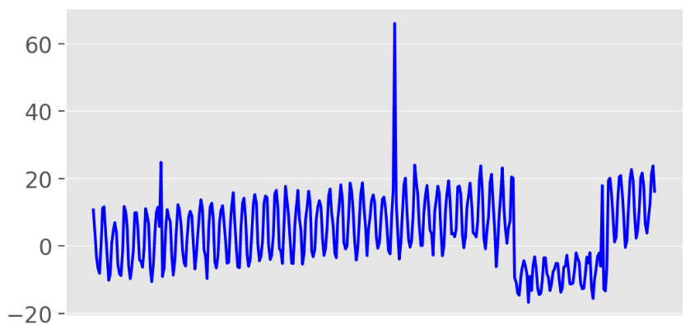
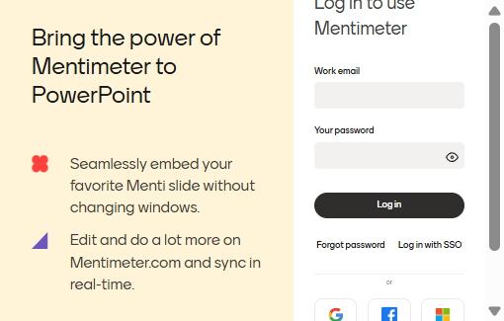
Lets talk Forecasting.
The Importance of GOOD Data.
How easy is it to forecast this time series?
Notes:
Ok now consider this time series

Slide 108
Lets talk Forecasting.
The Importance of GOOD Data.
Lets Decompose!
Notes:
AI voor sales predictie met beperkte data
AI vraagt veel data, hoe dit doen met weinig data
Verborgen structuren uitbuiten
De kennis uit dit project kunnen we op verder bouwen in de TETRA
Raad van advies/bestuur voor KMO’s
beroep doen op externe adviseurs leidt tot verbeterde besluitvormingskwaliteit,
toegenomen strategische planning en hogere bedrijfsperformantie
Project: beter begrip bij te brengen over het scala van adviesorganen dat ter beschikking is en hun te assisteren in een meer weloverwogen keuze
BedrijfsDNA: de weg naar mensgericht werk
Mensen aan boord krijgen + houden
Aanwerving: 62 % doorslaggevend is in jobkeuze is PURPOSE
Socials Return On Investment
Links:
https://www.vives.be/nl/onderzoek/business-management/ai-voor-sales-predictie-een-omgeving-met-beperkte-historische-data
https://www.vlaamsehogescholenraad.be/nl/ai_23_sales-predictie
https://www.vives.be/nl/onderzoek/business-management/leidraad-tot-een-succesvolle-raad-van-adviesbestuur-voor-startups-en
https://www.vives.be/nl/onderzoek/business-management/company-dna-road-humancentered-organisations

Slide 109
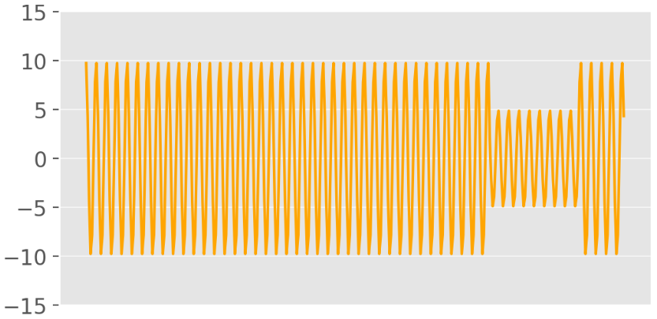
Lets talk Forecasting.
The Importance of GOOD Data.
Lets Decompose!
Weekly Seasonality
Repeated patterns every week
Notes:
AI voor sales predictie met beperkte data
AI vraagt veel data, hoe dit doen met weinig data
Verborgen structuren uitbuiten
De kennis uit dit project kunnen we op verder bouwen in de TETRA
Raad van advies/bestuur voor KMO’s
beroep doen op externe adviseurs leidt tot verbeterde besluitvormingskwaliteit,
toegenomen strategische planning en hogere bedrijfsperformantie
Project: beter begrip bij te brengen over het scala van adviesorganen dat ter beschikking is en hun te assisteren in een meer weloverwogen keuze
BedrijfsDNA: de weg naar mensgericht werk
Mensen aan boord krijgen + houden
Aanwerving: 62 % doorslaggevend is in jobkeuze is PURPOSE
Socials Return On Investment
Links:
https://www.vives.be/nl/onderzoek/business-management/ai-voor-sales-predictie-een-omgeving-met-beperkte-historische-data
https://www.vlaamsehogescholenraad.be/nl/ai_23_sales-predictie
https://www.vives.be/nl/onderzoek/business-management/leidraad-tot-een-succesvolle-raad-van-adviesbestuur-voor-startups-en
https://www.vives.be/nl/onderzoek/business-management/company-dna-road-humancentered-organisations

Slide 110
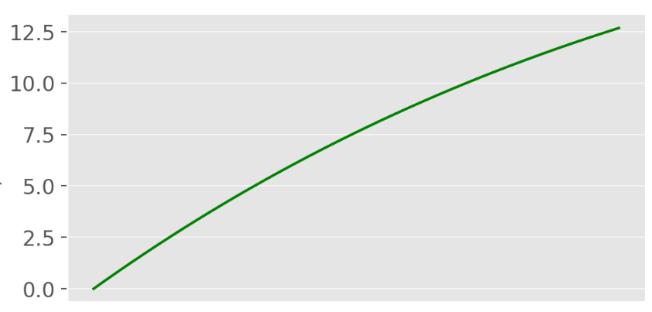
Lets talk Forecasting.
The Importance of GOOD Data.
Lets Decompose!
Weekly Seasonality
Trend
Repeated patterns every week
General upwards trend
Notes:
AI voor sales predictie met beperkte data
AI vraagt veel data, hoe dit doen met weinig data
Verborgen structuren uitbuiten
De kennis uit dit project kunnen we op verder bouwen in de TETRA
Raad van advies/bestuur voor KMO’s
beroep doen op externe adviseurs leidt tot verbeterde besluitvormingskwaliteit,
toegenomen strategische planning en hogere bedrijfsperformantie
Project: beter begrip bij te brengen over het scala van adviesorganen dat ter beschikking is en hun te assisteren in een meer weloverwogen keuze
BedrijfsDNA: de weg naar mensgericht werk
Mensen aan boord krijgen + houden
Aanwerving: 62 % doorslaggevend is in jobkeuze is PURPOSE
Socials Return On Investment
Links:
https://www.vives.be/nl/onderzoek/business-management/ai-voor-sales-predictie-een-omgeving-met-beperkte-historische-data
https://www.vlaamsehogescholenraad.be/nl/ai_23_sales-predictie
https://www.vives.be/nl/onderzoek/business-management/leidraad-tot-een-succesvolle-raad-van-adviesbestuur-voor-startups-en
https://www.vives.be/nl/onderzoek/business-management/company-dna-road-humancentered-organisations

Slide 111
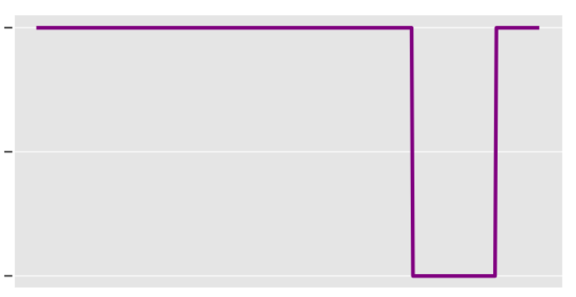
Lets talk Forecasting.
The Importance of GOOD Data.
Lets Decompose!
Weekly Seasonality
Trend
Holidays
Repeated patterns every week
General upwards trend
Drop due to holidays
Notes:
AI voor sales predictie met beperkte data
AI vraagt veel data, hoe dit doen met weinig data
Verborgen structuren uitbuiten
De kennis uit dit project kunnen we op verder bouwen in de TETRA
Raad van advies/bestuur voor KMO’s
beroep doen op externe adviseurs leidt tot verbeterde besluitvormingskwaliteit,
toegenomen strategische planning en hogere bedrijfsperformantie
Project: beter begrip bij te brengen over het scala van adviesorganen dat ter beschikking is en hun te assisteren in een meer weloverwogen keuze
BedrijfsDNA: de weg naar mensgericht werk
Mensen aan boord krijgen + houden
Aanwerving: 62 % doorslaggevend is in jobkeuze is PURPOSE
Socials Return On Investment
Links:
https://www.vives.be/nl/onderzoek/business-management/ai-voor-sales-predictie-een-omgeving-met-beperkte-historische-data
https://www.vlaamsehogescholenraad.be/nl/ai_23_sales-predictie
https://www.vives.be/nl/onderzoek/business-management/leidraad-tot-een-succesvolle-raad-van-adviesbestuur-voor-startups-en
https://www.vives.be/nl/onderzoek/business-management/company-dna-road-humancentered-organisations

Slide 112
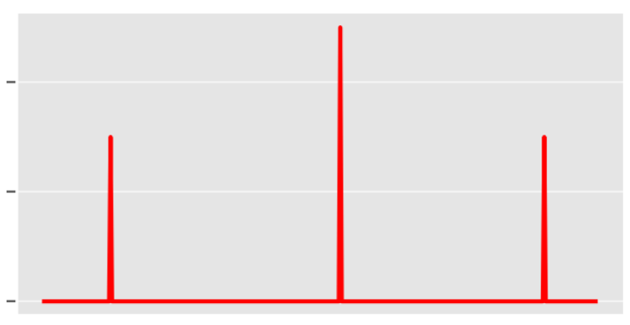
Lets talk Forecasting.
The Importance of GOOD Data.
Lets Decompose!
Weekly Seasonality
Trend
Holidays
Discounts
Repeated patterns every week
General upwards trend
Drop due to holidays
Spikes due to discounts
Notes:
AI voor sales predictie met beperkte data
AI vraagt veel data, hoe dit doen met weinig data
Verborgen structuren uitbuiten
De kennis uit dit project kunnen we op verder bouwen in de TETRA
Raad van advies/bestuur voor KMO’s
beroep doen op externe adviseurs leidt tot verbeterde besluitvormingskwaliteit,
toegenomen strategische planning en hogere bedrijfsperformantie
Project: beter begrip bij te brengen over het scala van adviesorganen dat ter beschikking is en hun te assisteren in een meer weloverwogen keuze
BedrijfsDNA: de weg naar mensgericht werk
Mensen aan boord krijgen + houden
Aanwerving: 62 % doorslaggevend is in jobkeuze is PURPOSE
Socials Return On Investment
Links:
https://www.vives.be/nl/onderzoek/business-management/ai-voor-sales-predictie-een-omgeving-met-beperkte-historische-data
https://www.vlaamsehogescholenraad.be/nl/ai_23_sales-predictie
https://www.vives.be/nl/onderzoek/business-management/leidraad-tot-een-succesvolle-raad-van-adviesbestuur-voor-startups-en
https://www.vives.be/nl/onderzoek/business-management/company-dna-road-humancentered-organisations

Slide 113
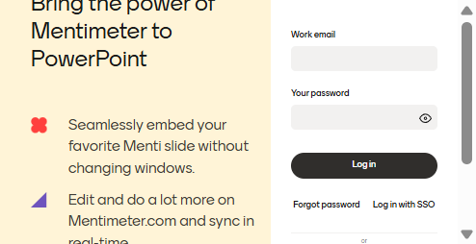
Lets talk Forecasting.
The Importance of GOOD Data.
Weekly Seasonality
Trend
Holidays
Discounts
Repeated patterns every week
General upwards trend
Drop due to holidays
Spikes due to discounts
Notes:
Better data leads to better predictions

Slide 114
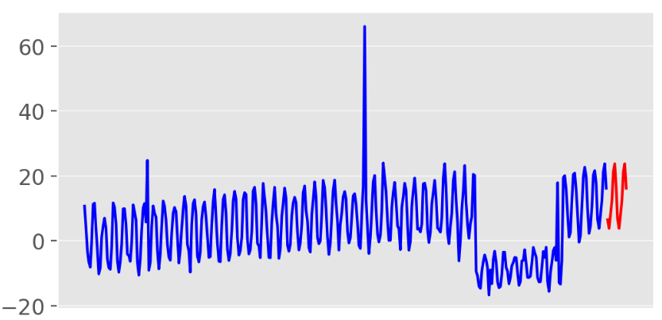
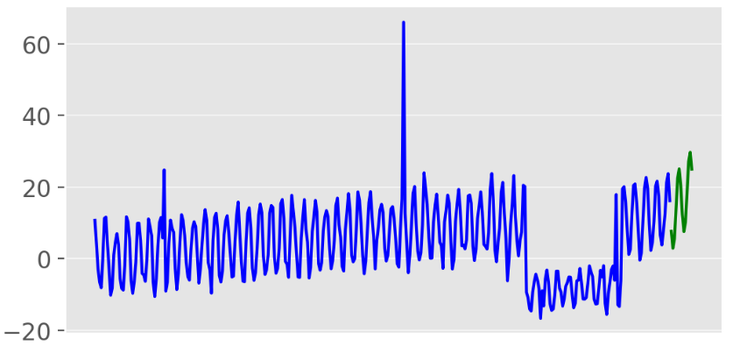
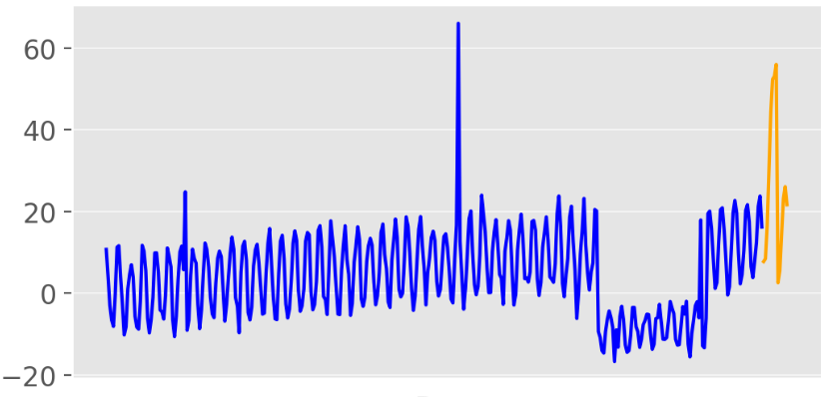
Model Selection.
Different Model Families
Simple Methods
(No parameters)
Repeat the same value
as last week!
Statistical Models
(Low complexity)
Consider seasonality, recent history and adjust for the ongoing trend!
AI Models
(Higher complexity)
Explore all available information and find patterns
Notes:
AI voor sales predictie met beperkte data
AI vraagt veel data, hoe dit doen met weinig data
Verborgen structuren uitbuiten
De kennis uit dit project kunnen we op verder bouwen in de TETRA
Raad van advies/bestuur voor KMO’s
beroep doen op externe adviseurs leidt tot verbeterde besluitvormingskwaliteit,
toegenomen strategische planning en hogere bedrijfsperformantie
Project: beter begrip bij te brengen over het scala van adviesorganen dat ter beschikking is en hun te assisteren in een meer weloverwogen keuze
BedrijfsDNA: de weg naar mensgericht werk
Mensen aan boord krijgen + houden
Aanwerving: 62 % doorslaggevend is in jobkeuze is PURPOSE
Socials Return On Investment
Links:
https://www.vives.be/nl/onderzoek/business-management/ai-voor-sales-predictie-een-omgeving-met-beperkte-historische-data
https://www.vlaamsehogescholenraad.be/nl/ai_23_sales-predictie
https://www.vives.be/nl/onderzoek/business-management/leidraad-tot-een-succesvolle-raad-van-adviesbestuur-voor-startups-en
https://www.vives.be/nl/onderzoek/business-management/company-dna-road-humancentered-organisations

Slide 115

Model Selection.
Free Lunch Theorem
There is no model that is universally better at every task
Hidden rule: A simple model can perform much better than a complex one
Notes:
AI voor sales predictie met beperkte data
AI vraagt veel data, hoe dit doen met weinig data
Verborgen structuren uitbuiten
De kennis uit dit project kunnen we op verder bouwen in de TETRA
Raad van advies/bestuur voor KMO’s
beroep doen op externe adviseurs leidt tot verbeterde besluitvormingskwaliteit,
toegenomen strategische planning en hogere bedrijfsperformantie
Project: beter begrip bij te brengen over het scala van adviesorganen dat ter beschikking is en hun te assisteren in een meer weloverwogen keuze
BedrijfsDNA: de weg naar mensgericht werk
Mensen aan boord krijgen + houden
Aanwerving: 62 % doorslaggevend is in jobkeuze is PURPOSE
Socials Return On Investment
Links:
https://www.vives.be/nl/onderzoek/business-management/ai-voor-sales-predictie-een-omgeving-met-beperkte-historische-data
https://www.vlaamsehogescholenraad.be/nl/ai_23_sales-predictie
https://www.vives.be/nl/onderzoek/business-management/leidraad-tot-een-succesvolle-raad-van-adviesbestuur-voor-startups-en
https://www.vives.be/nl/onderzoek/business-management/company-dna-road-humancentered-organisations

Slide 116

Model Selection.
A Quick Reality Check
Tips:
I have a mediocre laptop!
SimplestStatistical model < 5 seconds
Our AI model < 1.5 minute
Simple Photo Recognition on your phone < 250 days
Notes:
463 years!

Slide 117

Model Selection.
A Quick Reality Check
Tips:
I have a mediocre laptop!
Statistical model < 5 seconds
Our model < 30 seconds
Simple Photo Recognition in your phone < 250 days
463 years!!!
Notes:
463 years!

Slide 118
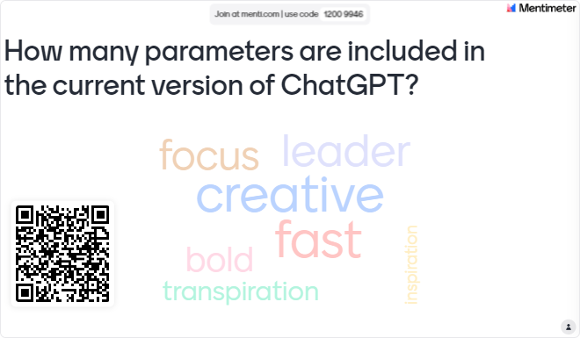
Model Selection.
A Quick Reality Check
Tips:
Statistical Models 0€
Our Model 0€
Simple Photo Recognition on your phone 10€ (Monthly subscription to GPUs)
Notes:
Answer is 1.7Trillion
Use a meter and take the average

Slide 119
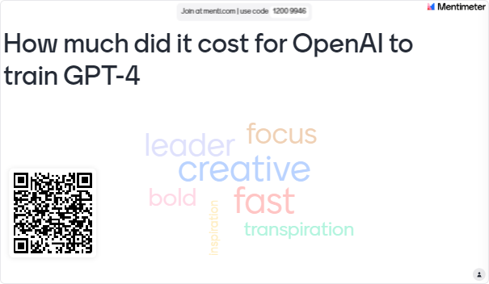
Model Selection.
A Quick Reality Check
Tips:
Statistical Models 0€
Our Model 0€
Simple Photo Recognition on your phone 10€ (Monthly subscription to GPUs)
Over 100M€
Notes:
Answer is 1.7Trillion
Use a meter and take the average

Slide 120
Model Selection.
Pick your Weapon Carefully
Remember Feasibility?
There is a limit to how accurately we can predict!
So why use a Bazooka for an Ant?
Notes:
AI voor sales predictie met beperkte data
AI vraagt veel data, hoe dit doen met weinig data
Verborgen structuren uitbuiten
De kennis uit dit project kunnen we op verder bouwen in de TETRA
Raad van advies/bestuur voor KMO’s
beroep doen op externe adviseurs leidt tot verbeterde besluitvormingskwaliteit,
toegenomen strategische planning en hogere bedrijfsperformantie
Project: beter begrip bij te brengen over het scala van adviesorganen dat ter beschikking is en hun te assisteren in een meer weloverwogen keuze
BedrijfsDNA: de weg naar mensgericht werk
Mensen aan boord krijgen + houden
Aanwerving: 62 % doorslaggevend is in jobkeuze is PURPOSE
Socials Return On Investment
Links:
https://www.vives.be/nl/onderzoek/business-management/ai-voor-sales-predictie-een-omgeving-met-beperkte-historische-data
https://www.vlaamsehogescholenraad.be/nl/ai_23_sales-predictie
https://www.vives.be/nl/onderzoek/business-management/leidraad-tot-een-succesvolle-raad-van-adviesbestuur-voor-startups-en
https://www.vives.be/nl/onderzoek/business-management/company-dna-road-humancentered-organisations

Slide 121

Model Selection.
Pick your Weapon Carefully
Remember Feasibility?
There is a limit to how accurately we can predict!
So why use a Bazooka for an Ant?
Inexperienced Data Scientist
Take the most complex model
Train it
Pray to the AI Gods.
Notes:
AI voor sales predictie met beperkte data
AI vraagt veel data, hoe dit doen met weinig data
Verborgen structuren uitbuiten
De kennis uit dit project kunnen we op verder bouwen in de TETRA
Raad van advies/bestuur voor KMO’s
beroep doen op externe adviseurs leidt tot verbeterde besluitvormingskwaliteit,
toegenomen strategische planning en hogere bedrijfsperformantie
Project: beter begrip bij te brengen over het scala van adviesorganen dat ter beschikking is en hun te assisteren in een meer weloverwogen keuze
BedrijfsDNA: de weg naar mensgericht werk
Mensen aan boord krijgen + houden
Aanwerving: 62 % doorslaggevend is in jobkeuze is PURPOSE
Socials Return On Investment
Links:
https://www.vives.be/nl/onderzoek/business-management/ai-voor-sales-predictie-een-omgeving-met-beperkte-historische-data
https://www.vlaamsehogescholenraad.be/nl/ai_23_sales-predictie
https://www.vives.be/nl/onderzoek/business-management/leidraad-tot-een-succesvolle-raad-van-adviesbestuur-voor-startups-en
https://www.vives.be/nl/onderzoek/business-management/company-dna-road-humancentered-organisations

Slide 122

Model Selection.
Pick your Weapon Carefully
Remember Feasibility?
There is a limit to how accurately we can predict!
So why use a Bazooka for an Ant?
Inexperienced Data Scientist
Experienced Data Scientist
Agreed added value not reached
Take the most complex model
Train it
Pray to the AI Gods.
Understand the task
Start Simple
Evaluate
Understand why the model failed
Increase complexity
Agreed added value reached
Go for a beers
Notes:
AI voor sales predictie met beperkte data
AI vraagt veel data, hoe dit doen met weinig data
Verborgen structuren uitbuiten
De kennis uit dit project kunnen we op verder bouwen in de TETRA
Raad van advies/bestuur voor KMO’s
beroep doen op externe adviseurs leidt tot verbeterde besluitvormingskwaliteit,
toegenomen strategische planning en hogere bedrijfsperformantie
Project: beter begrip bij te brengen over het scala van adviesorganen dat ter beschikking is en hun te assisteren in een meer weloverwogen keuze
BedrijfsDNA: de weg naar mensgericht werk
Mensen aan boord krijgen + houden
Aanwerving: 62 % doorslaggevend is in jobkeuze is PURPOSE
Socials Return On Investment
Links:
https://www.vives.be/nl/onderzoek/business-management/ai-voor-sales-predictie-een-omgeving-met-beperkte-historische-data
https://www.vlaamsehogescholenraad.be/nl/ai_23_sales-predictie
https://www.vives.be/nl/onderzoek/business-management/leidraad-tot-een-succesvolle-raad-van-adviesbestuur-voor-startups-en
https://www.vives.be/nl/onderzoek/business-management/company-dna-road-humancentered-organisations

Slide 123
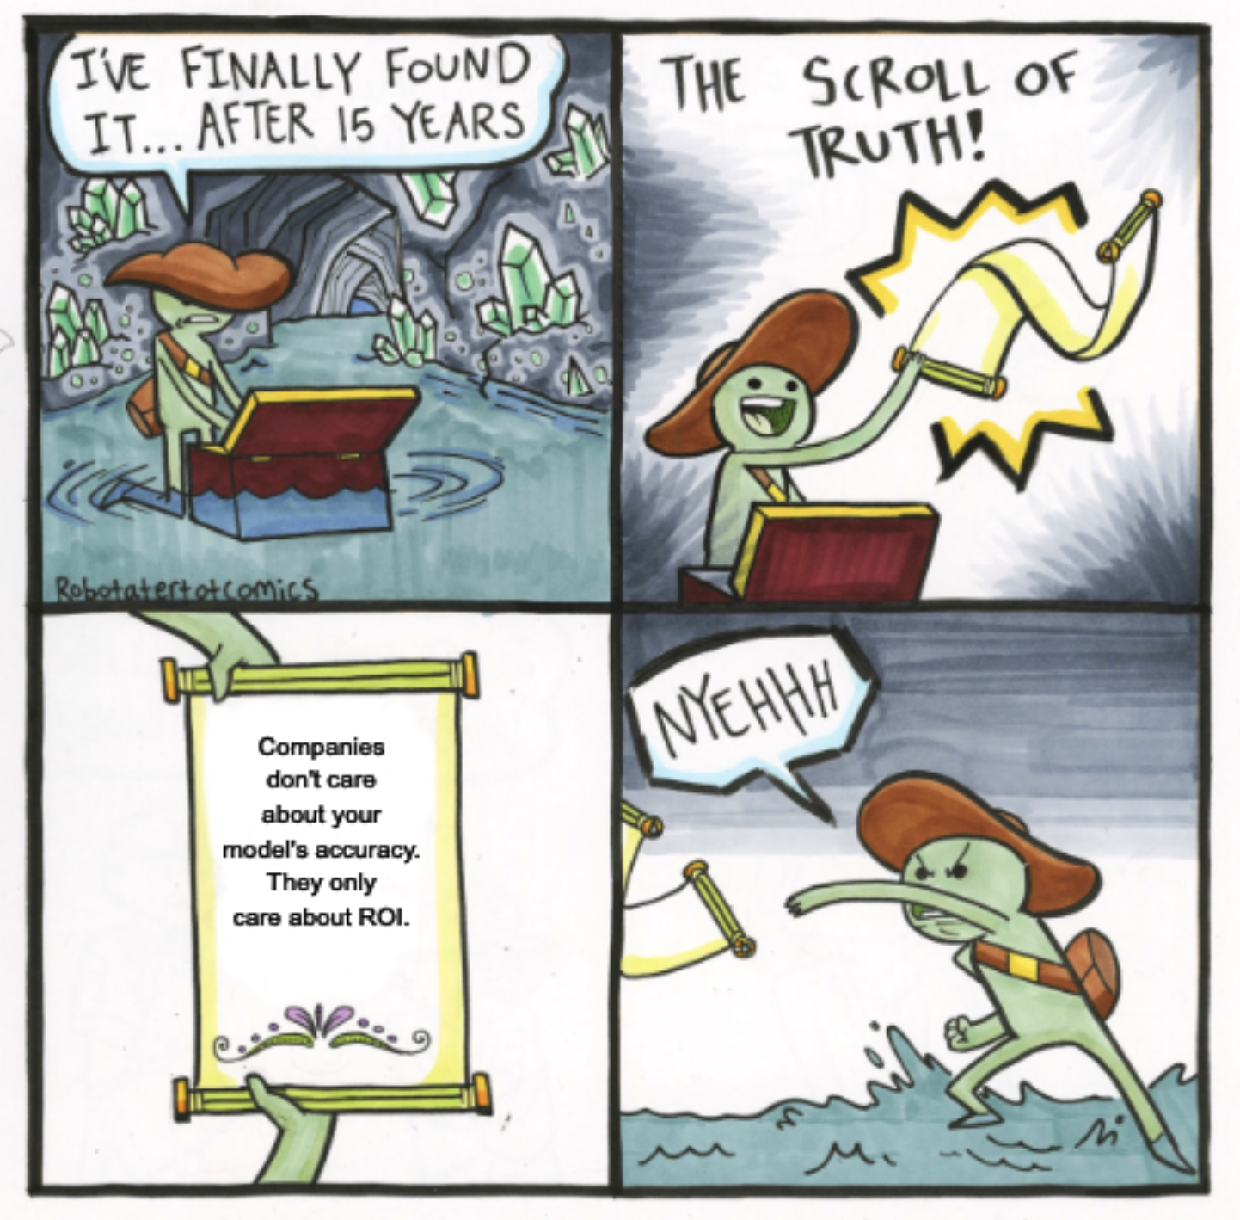
Model Selection.
Measuring the Added Value
How much accuracy improvement is enough?
Scenario 1:
Model A: 90% accuracy, Cost to run -> 100.000 €/month
Model B: 80% accuracy, Cost to run-> 2.000 €/ month
Is a 10% increase worth 50x higher costs? (Usually) No
Scenario 2:
Model A: 85% accuracy Cost to run -> 20.000 €/month
Model B: 84% accuracy, Cost to run -> 10.000 €/ month
Is a 1% improvement worth 2x higher costs? (Usually) Yes!
Notes:
Read this if there is time!
One has a ROI of 0.04, the other has 2% which means millions

Slide 124
Workshop!
Agenda!
A (Brief) Introduction to AI.
Applying AI in practice.
Lets talk Forecasting!
Model Selection.
Takeaways!

Slide 125
Takeaways!
Pittfalls & Suggestions.
(Unfortunately) there is no alternative for forecasting.
You can't achieve unlimited accuracy.
No bad forecasts, bad forecasting practices.
Decision makers across functions should be aligned (Scoping is key!)
Watch out for human biases in forecast corrections (Remember Mark, the sales manager)
  Humans can improve forecasts by adding extra knowledge.
  They can also worsen them by adding their biases.
Trusting the forecast of a complex model takes time and effort.
Notes:
Kolasa 20.1, 16.3

Slide 126
Break!

Slide 127
Applying AI in Practise.
Two Key Questions on Data
How much data is enough data?
Depends!
Example: If your data has seasonal variations, multiple seasonal circles are needed
Notes:
How much data is good enough?
Well it depends on the task. How hard it is and how many variability htere are on different cases.
For example if I have multiple seasonal variations on data and I expect my model to get it I need multiple seasonal circles.

Slide 128
Applying AI in Practise.
Two Key Questions on Data
How much data is enough data?
Depends!
Example: If your data has seasonal variations, multiple seasonal circles are needed
What is high quality data?
Relevant -> Data should match the domain of the task.
Representitive -> Data should reflect the diversity and the variability of the task.
Reliable -> Data should be accurate, consistent and complete.
Responsible -> Data should be ethical, legal and respectfull of the rights and interests.
Notes:
And these are the textbook properties of what is good data.
Data should match the domain. Forecasting sales needs sales data
Representatitve, have eaxmples of variabilities in the task
They should be clean, consisent and complete.
And finally something most people forget nowdays, they should be ethically gathered!

Slide 129
Lets talk Forecasting.
What is the Point of Forecasting?
“Planning is bringing the future into the present so you can do something about it now”
We want to predict the future in order to act now!
Every decision under uncertainty requires a forecast
To formalize: Forecasting is a tool to support decision making
Formally:
Find best action α that minimizes the expected cost depending on the action and the forecast
Notes:
Let me throw some maths here. So what we want is to optimize or decision making. And we do that by considering our forecasts!

Slide 130
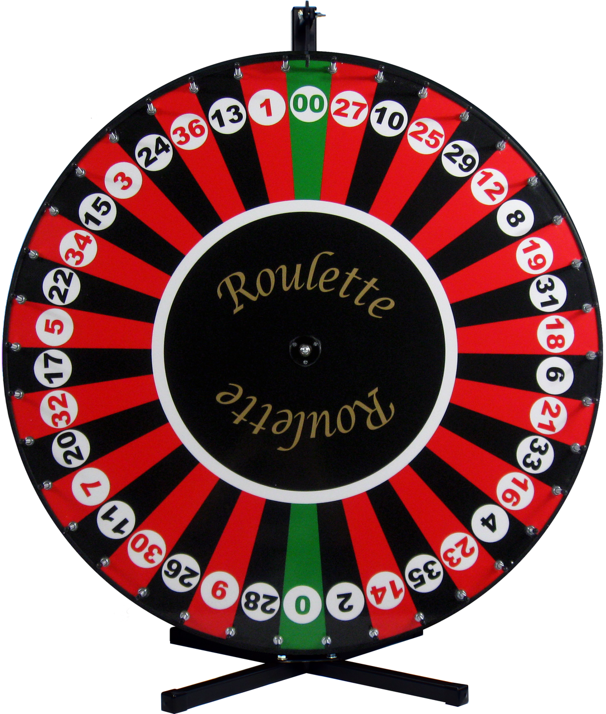
Lets talk Forecasting.
Improving our Practises!
Notes:
Ok now lets see this example. I hope you are familiar with roulete. So the idea is that you pick a number and hope that the ball will end up in your number

Slide 131
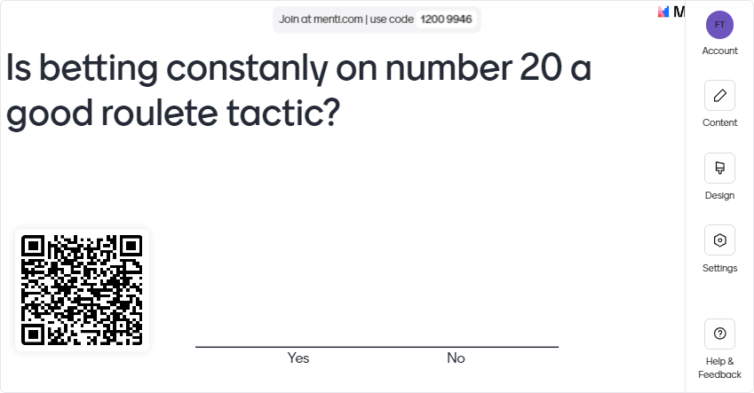
Lets talk Forecasting.
Improving our Practises!
Notes:
And I am asking you the following!

Slide 132
Lets talk Forecasting.
Improving our Practises!
Betting constantly on #20 and losing is not a bad choice
Betting constantly on #20 and winning is not a good choice
Notes:
The answer is more tricky. Betting on 20 and lossing is not a bad choice.
Similarly, betting on 20 and winning is not a good choice either.
Actualy betting on any number does not make a difference! There is equal probability for you winning.

Slide 133
Lets talk Forecasting.
Improving our Practises!
Betting constantly on #20 and losing is not a bad choice
Betting constantly on #20 and winning is not a good choice
1. Collect as much relevant information as possible.
If the process is good and the forecast is not accurate => Bad Luck
If the process is bad and the forecast accurate => Lucky
2. Do not question the quality of the forecast given the outcome.
Question the process to get the outcome.
Notes:
The takeaways! Improve how you do the forecasting and evaluate this. Dont evaluate based on an event only!!
If the process is good and the forecast was not accurate, it was bad luck.
And vice versa. If you had a bad process and the forecast was accuracate, you were just lucky!!

Slide 134
Lets talk Forecasting.
Forecastability! What Can We Forecast!
There is a threshold on “how much” can we predict
Why? Noise!
Different time series are more or less predictable.
They contain more or less noise.
Noise is unexplained variations.
You can picture noise as patterns we don’t have information to explain

